Slide 1
Year 6 Residential 2026
PGL Barton Hall
Torquay

Slide 2
PGL Residentials
PGL is the UK’s leading provider of outdoor education.
With over 65 years of experience delivering outdoor adventures, they provide a range of programmes, designed specifically for residential school trips.
Situated in 46 acres of the Devon countryside, the centre, just outside Torquay, sits on the English Riviera.
Barton Hall offers adventure activities with facilities such as a heated outdoor pool and a lake for watersports.
En suite accommodation in the mansion house

Slide 3
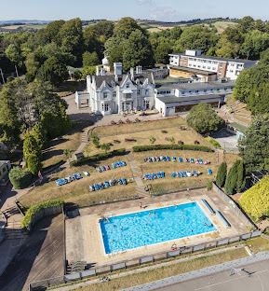

Slide 4
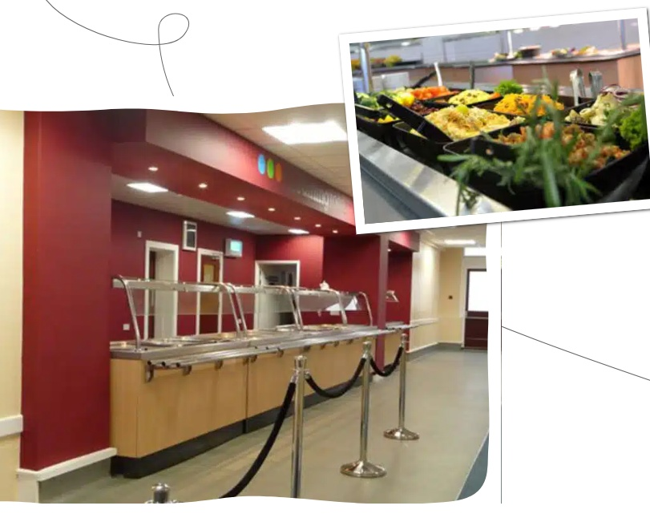
Food at Barton Hall
Enjoyable mealtimes with nutritious and tasty food.
Whilst at PGL you’ll enjoy three tasty meals a day – all nutritionally balanced to provide plenty of energy to keep you going all day!
Our catering team can cater for any allergies or special dietary requirements, and can even can provide packed lunches if preferred.
A mix of hot and cold meals with vegetarian options
Self-service salad bar
Fresh fruit with every meal
Allergies, intolerances and special diets catered for
Support for fussy eaters

Slide 5
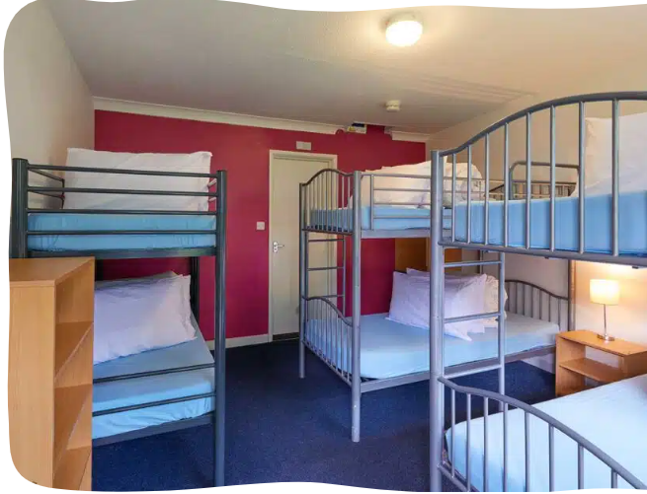
Accommodation at Barton Hall
The rooms in the Main House are dormitory-style, each sleeping 4-10 children in bunk beds, with en suite bathrooms.

Slide 6
Outdoor Education
The benefits-
FUN!
Challenging
Team work
New experiences
Developing responsibility

Slide 7
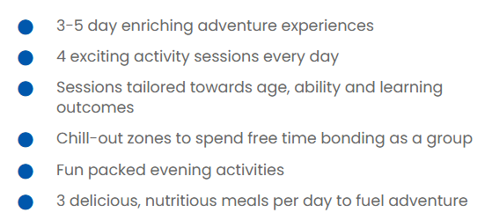
Multi-Activity Programme Overview

Slide 8
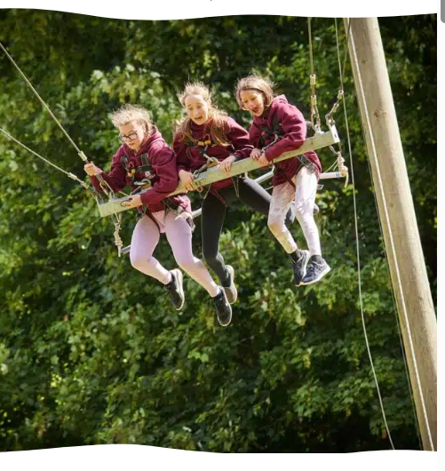
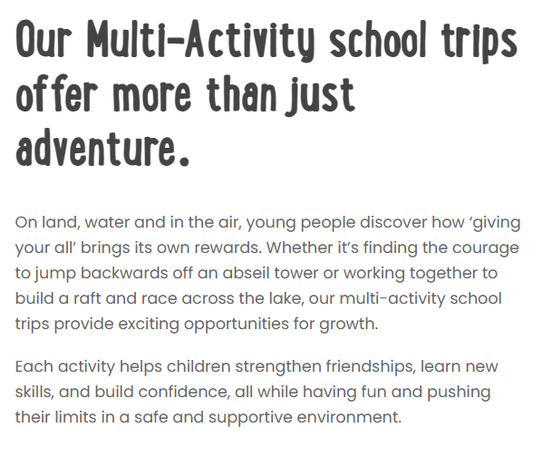
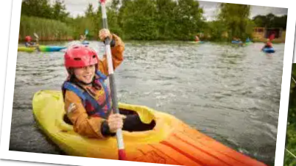
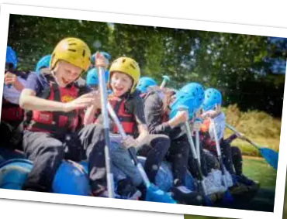
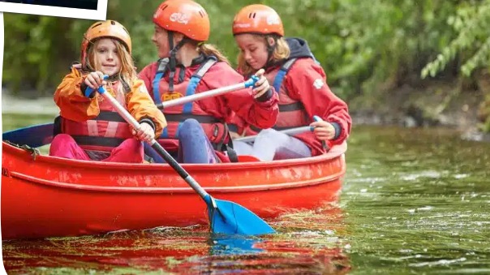

Slide 9
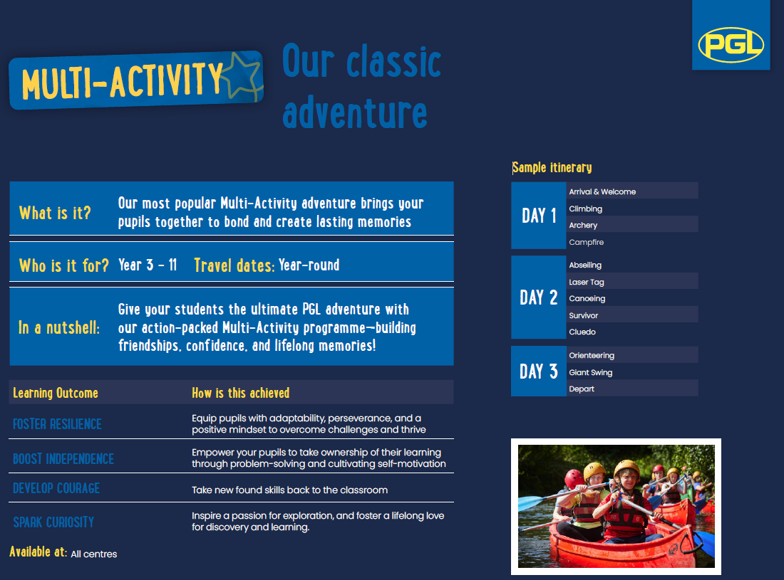
Sample itinerary

Slide 10
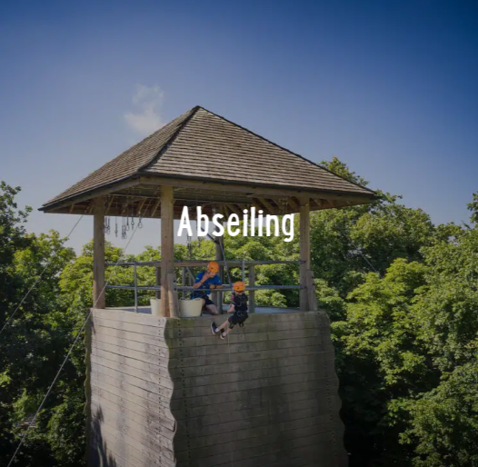
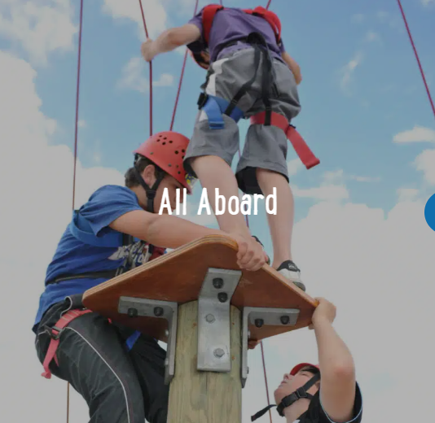
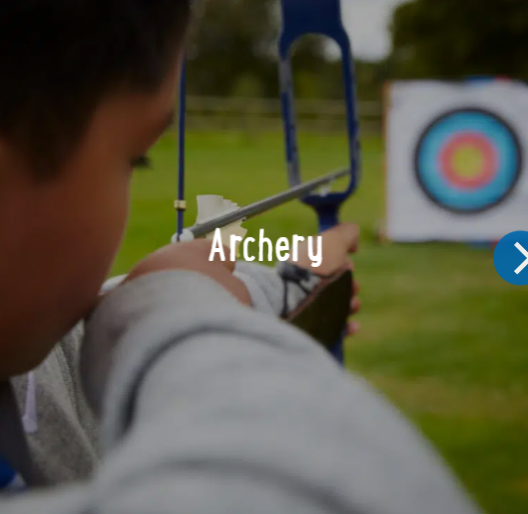
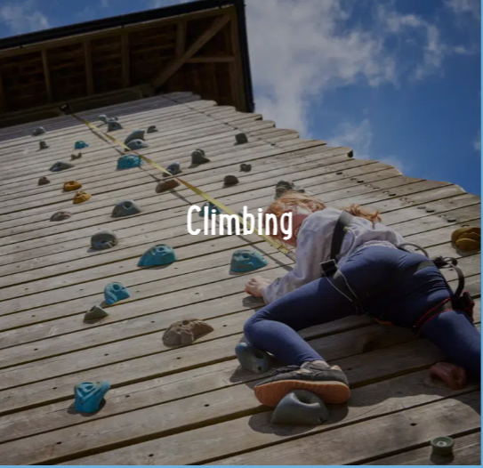
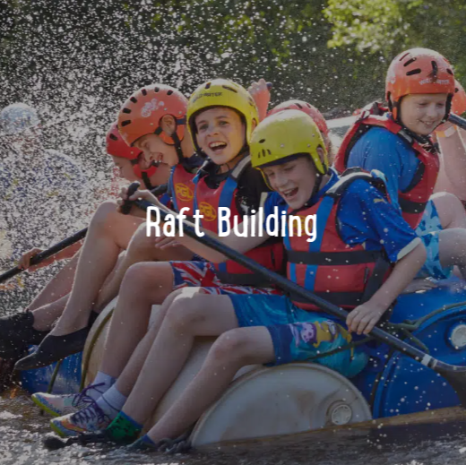
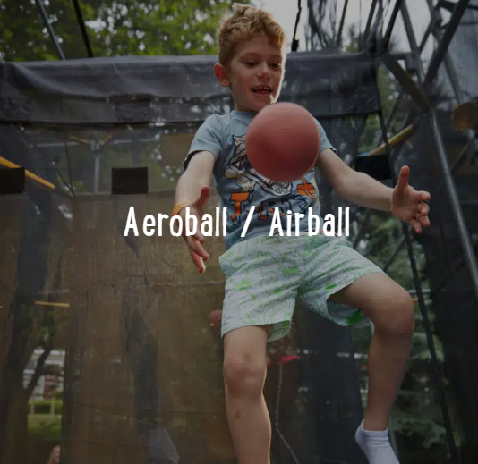
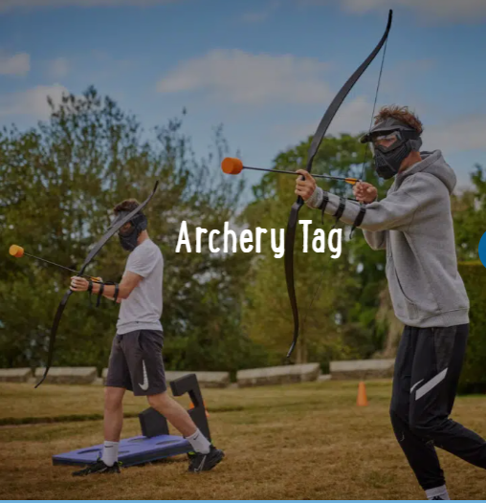
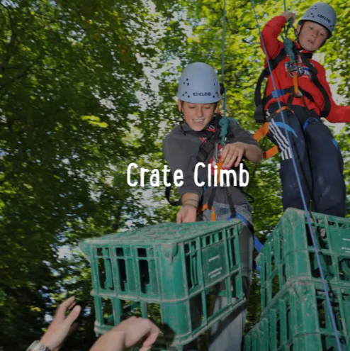
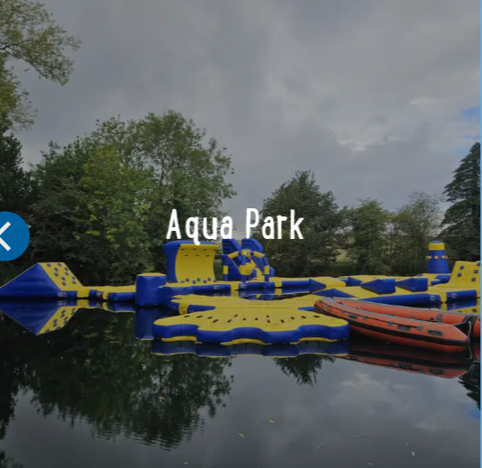
Daytime Activities

Slide 11
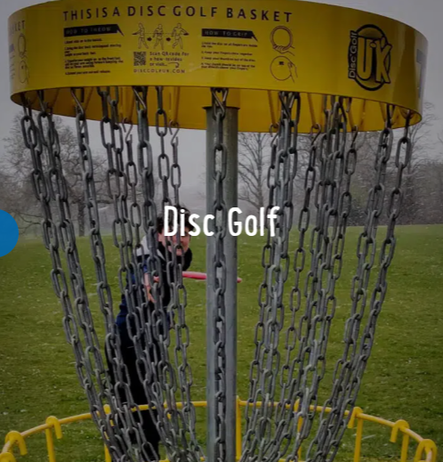


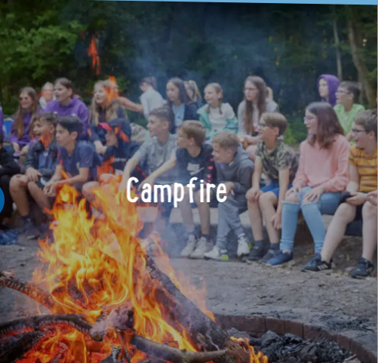
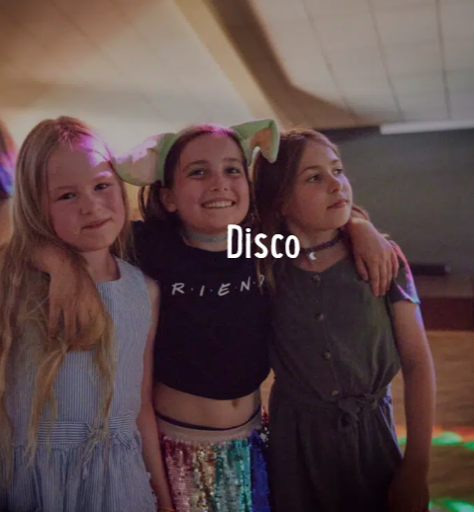
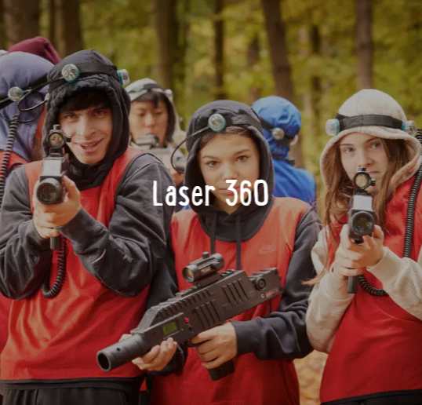
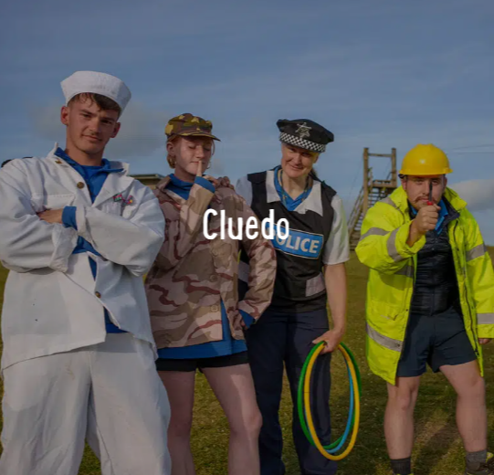
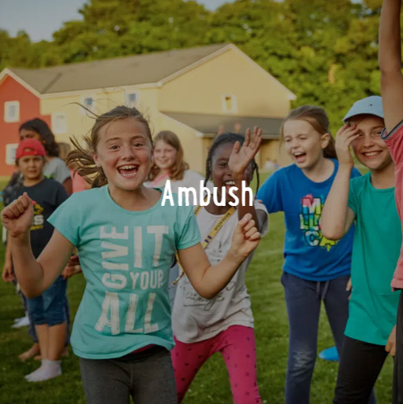
Evening Activities

Slide 12
Any Questions?

