Slide 1
Year 6 Residential 2025
Porthpean

Slide 2
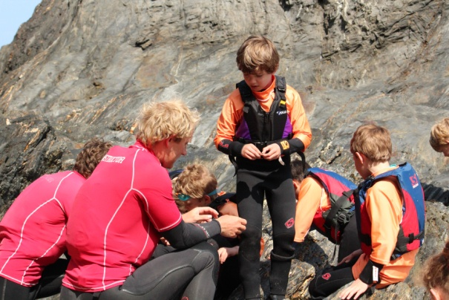
Cornwall Adventure LTD
Lease holders of Porthpean Outdoor Education Centre
Many years experience organising and hosting school
residential trips in Newquay as First Wave Adventures
Mark- Over 20 years experience working with children in schools, colleges, sports coaching
Chris-16 years experience as a POEC Instructor and Trainer-everybody’s favourite!
Promise to continue to offer activity residentials for local school children

Slide 3
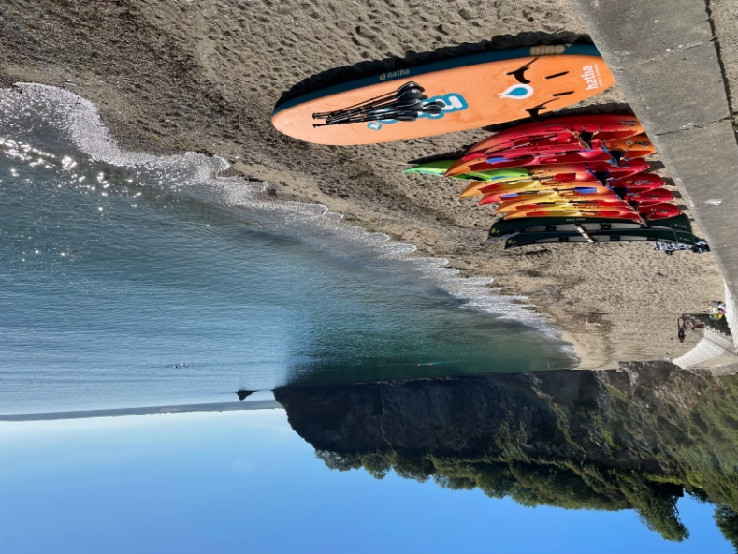
Our Aim
To provide schools and families with the GREATEST activity-led residential experience.
Ever!

Slide 4
Outdoor Education
The benefits-
FUN!
Challenging
Team work
New experiences
Developing responsibility

Slide 5
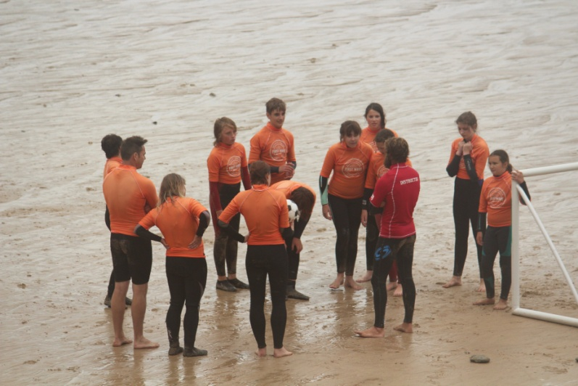
How?
Recruiting the best instructor team
Investing in new equipment and ideas
Following the strictest health and safety policy
Making sure that every child and every guest feel like they are the most important person on earth
Doing everything we can to make ever minute with us safe, fun, challenging, exciting, rewarding, memorable

Slide 6
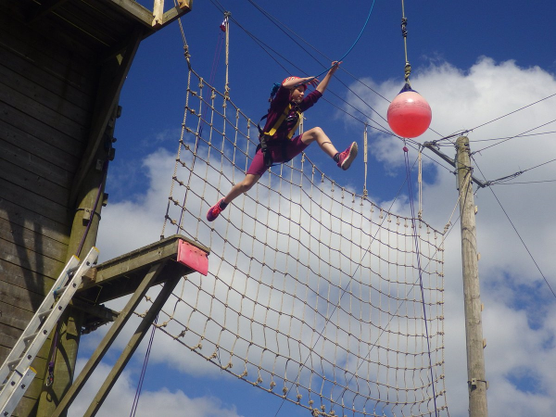
Why?
We want to give as many children as possible the most engaging and exciting experience.
We want to help develop inner strength, confidence, resilience, and a taste for adventure.
We want to give everyone an experience that they will treasure for the rest of their lives

Slide 7
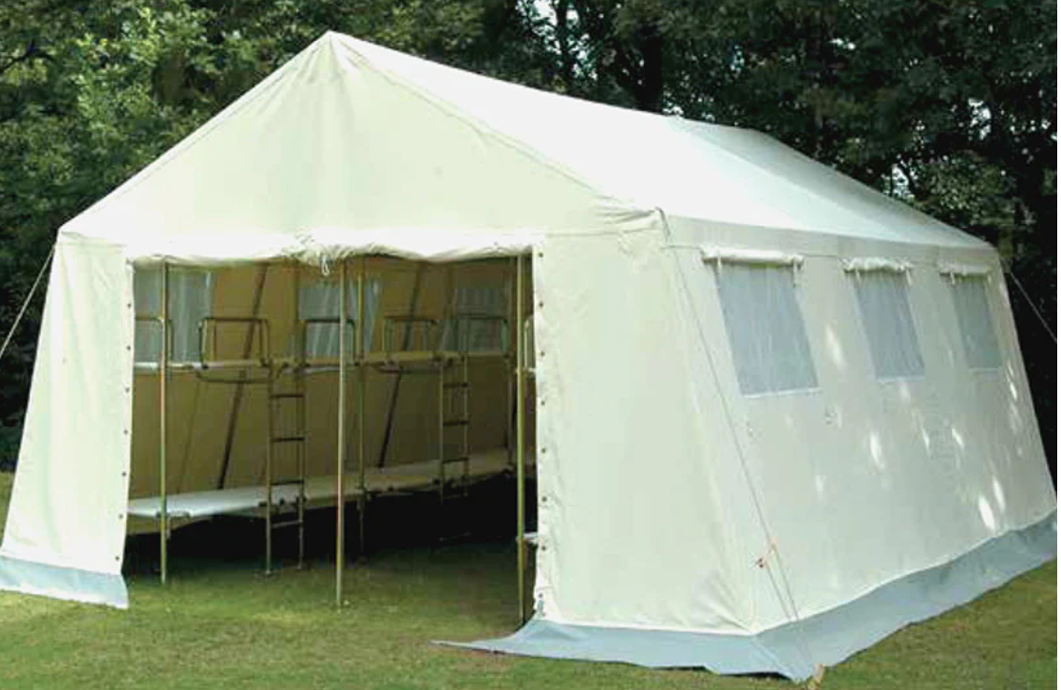
What’s New

Slide 8
Catering
Ogy1 provide our catering, including cooked breakfasts, packed lunches, evening dinners and BBQ’s
They will ensure everyone is well fed and have every dietary requirement met (pancakes unfortunately, are not classed as a dietary requirement!)
Caterers understand allergies and will adapt to meet everybody’s needs

Slide 9
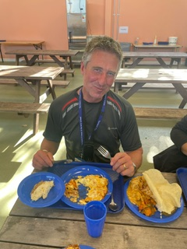

Slide 10
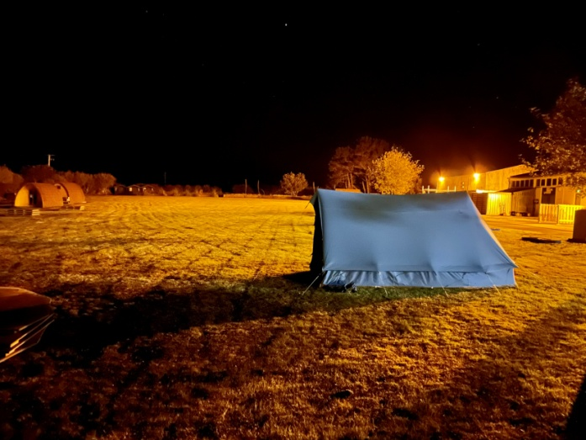
Night Time
The centre will be secured every night
A member of the Porthpean Outdoor Education team will be at the centre over night.
They will have an enhanced DBS certificate
They will be fully trained in our safeguarding policy
They will be available should they be needed.
Children should be aware that their school teachers should be the first point of contact if they need anything during the night

Slide 11
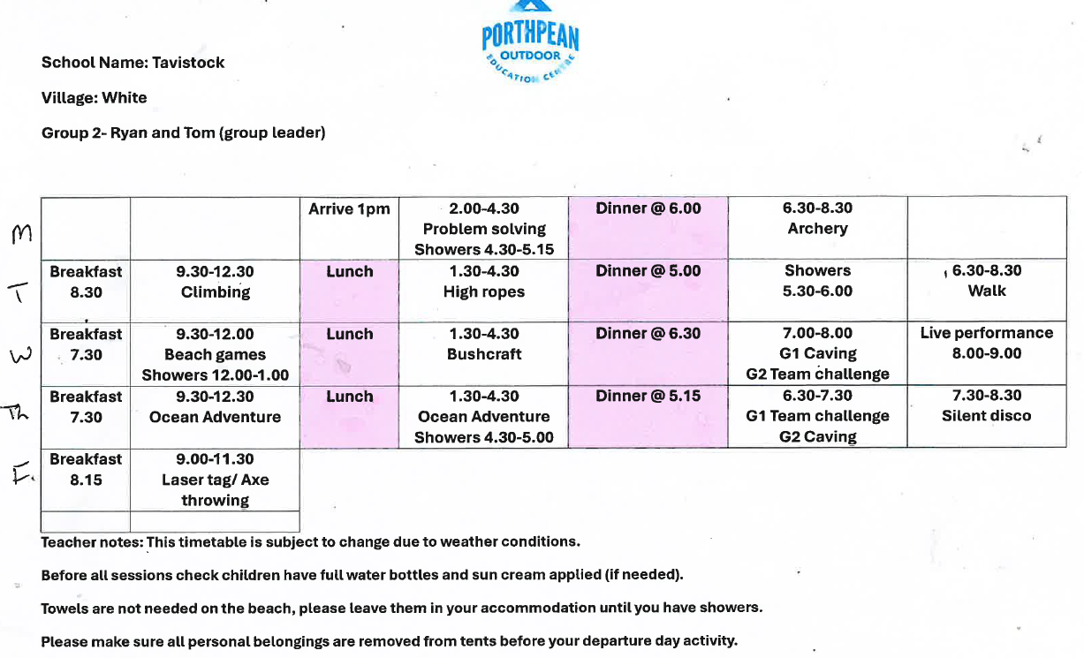

Slide 12
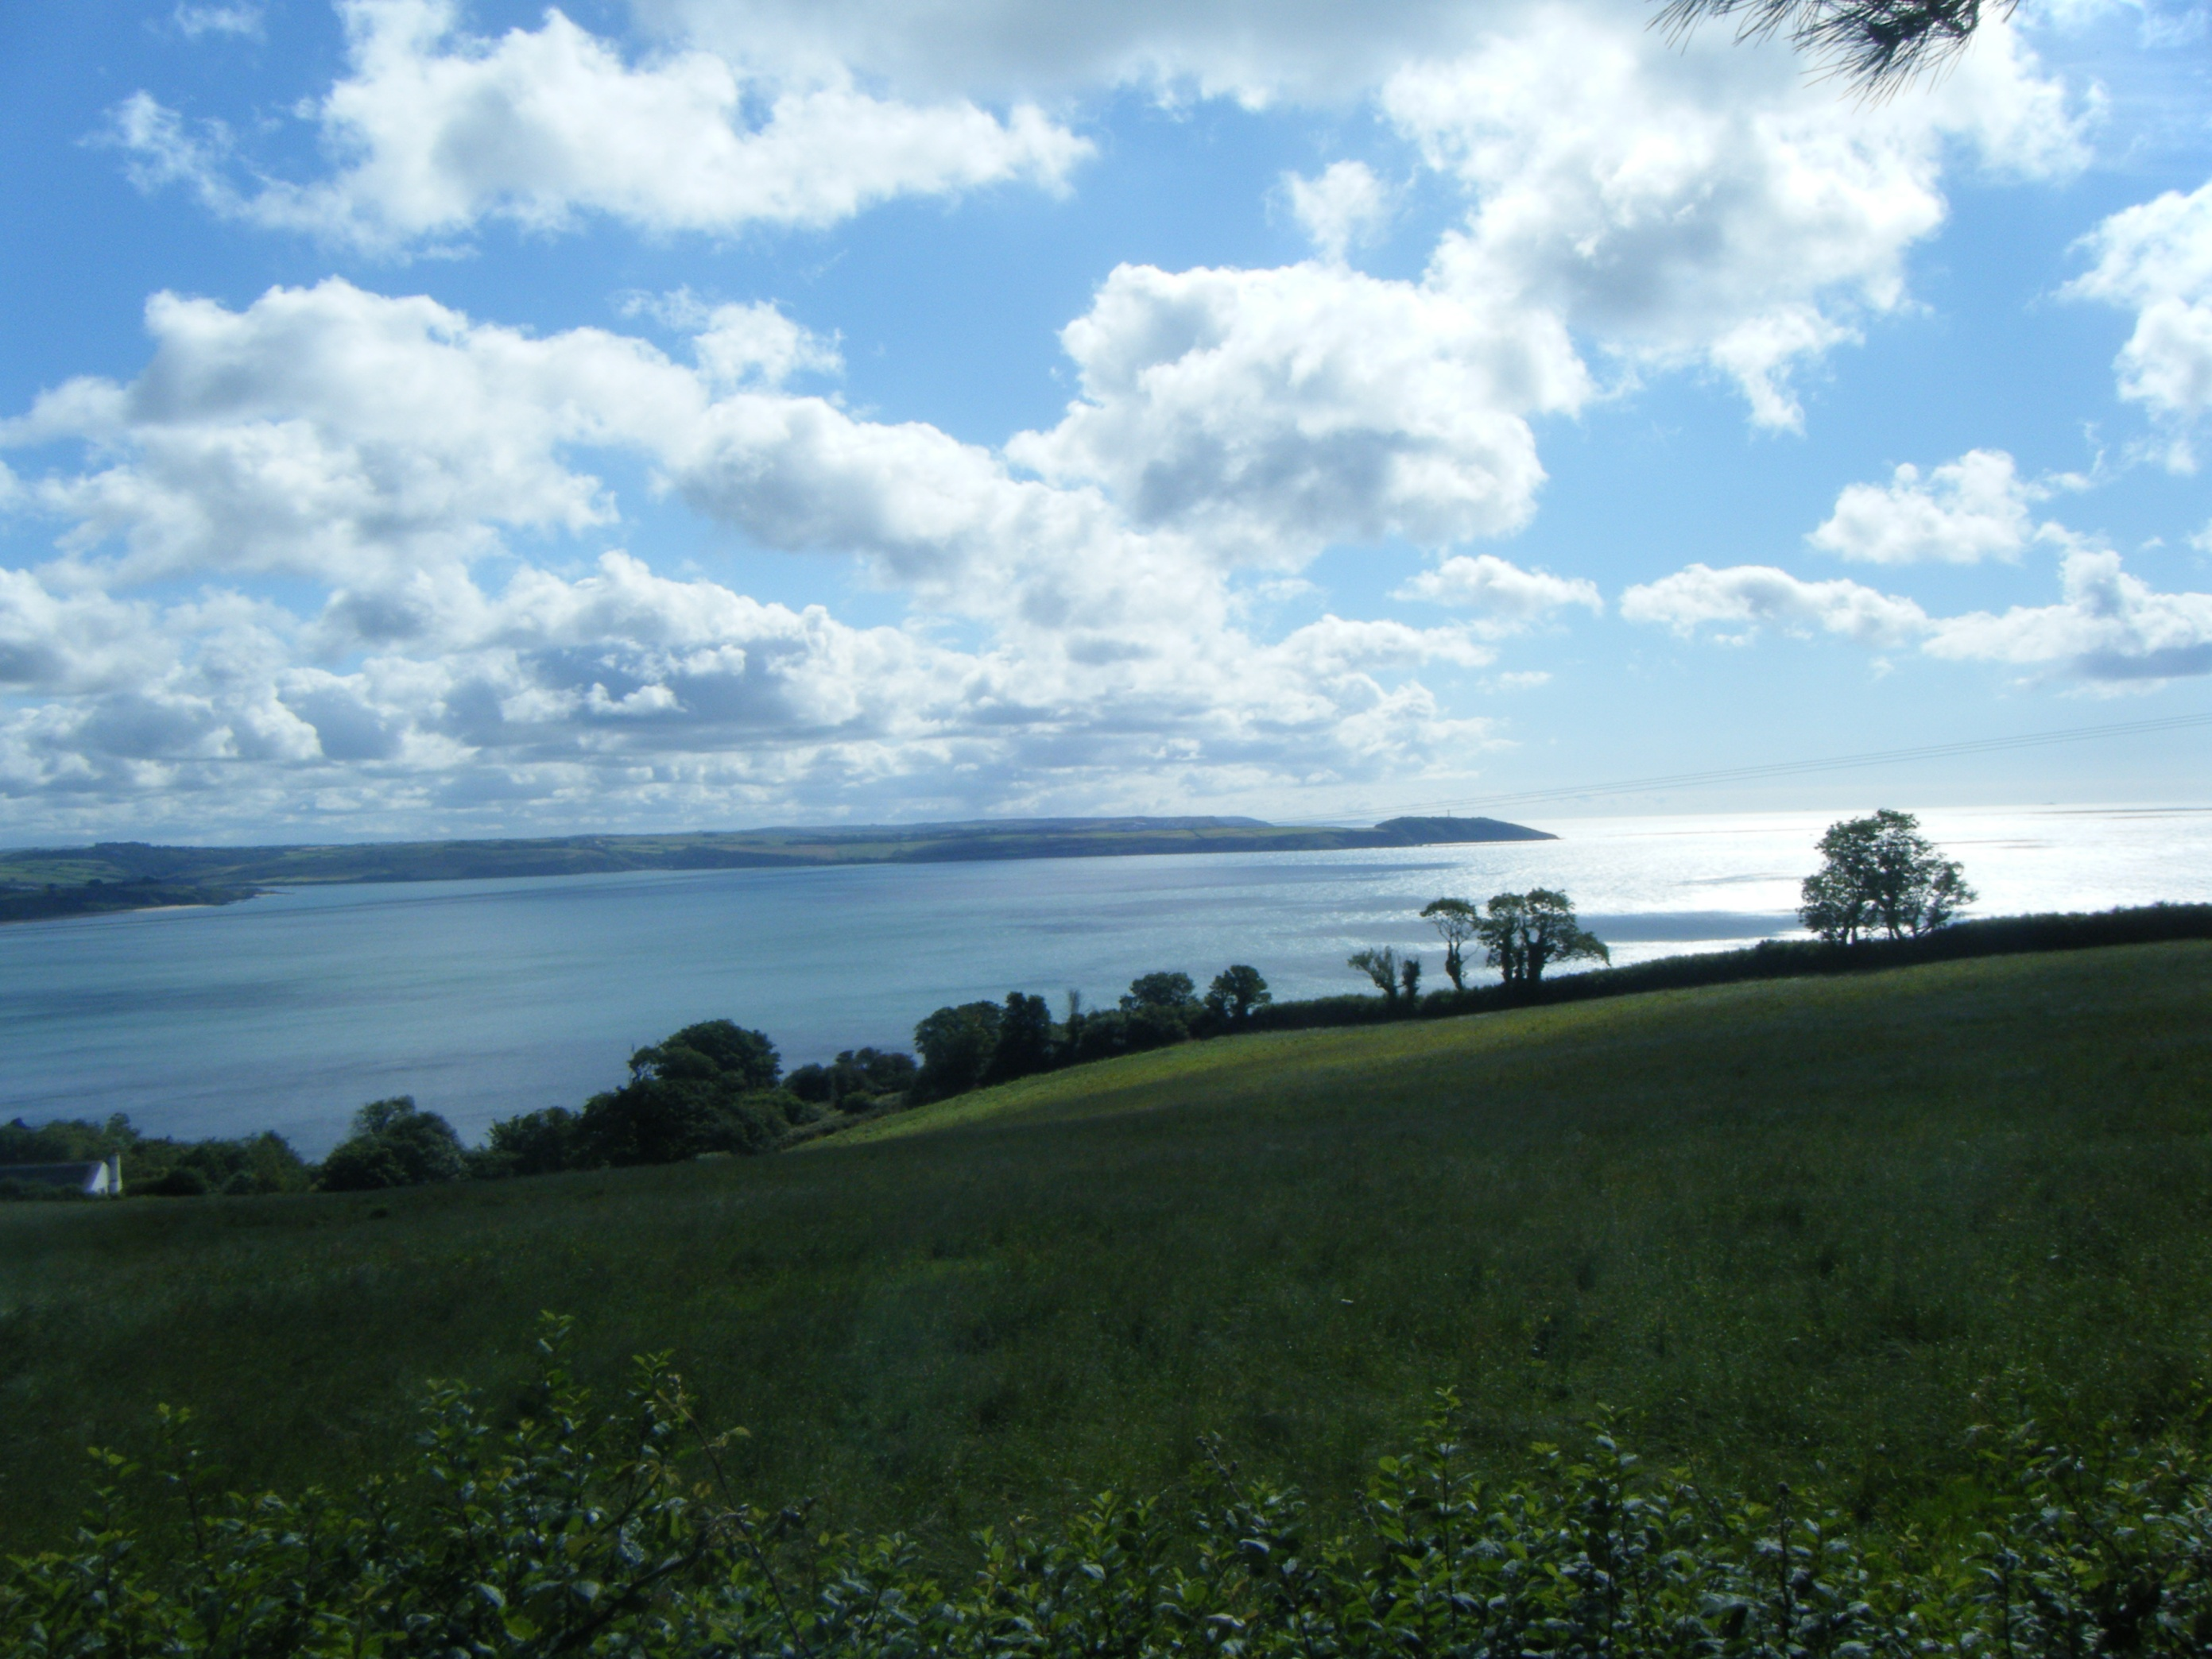

Slide 13
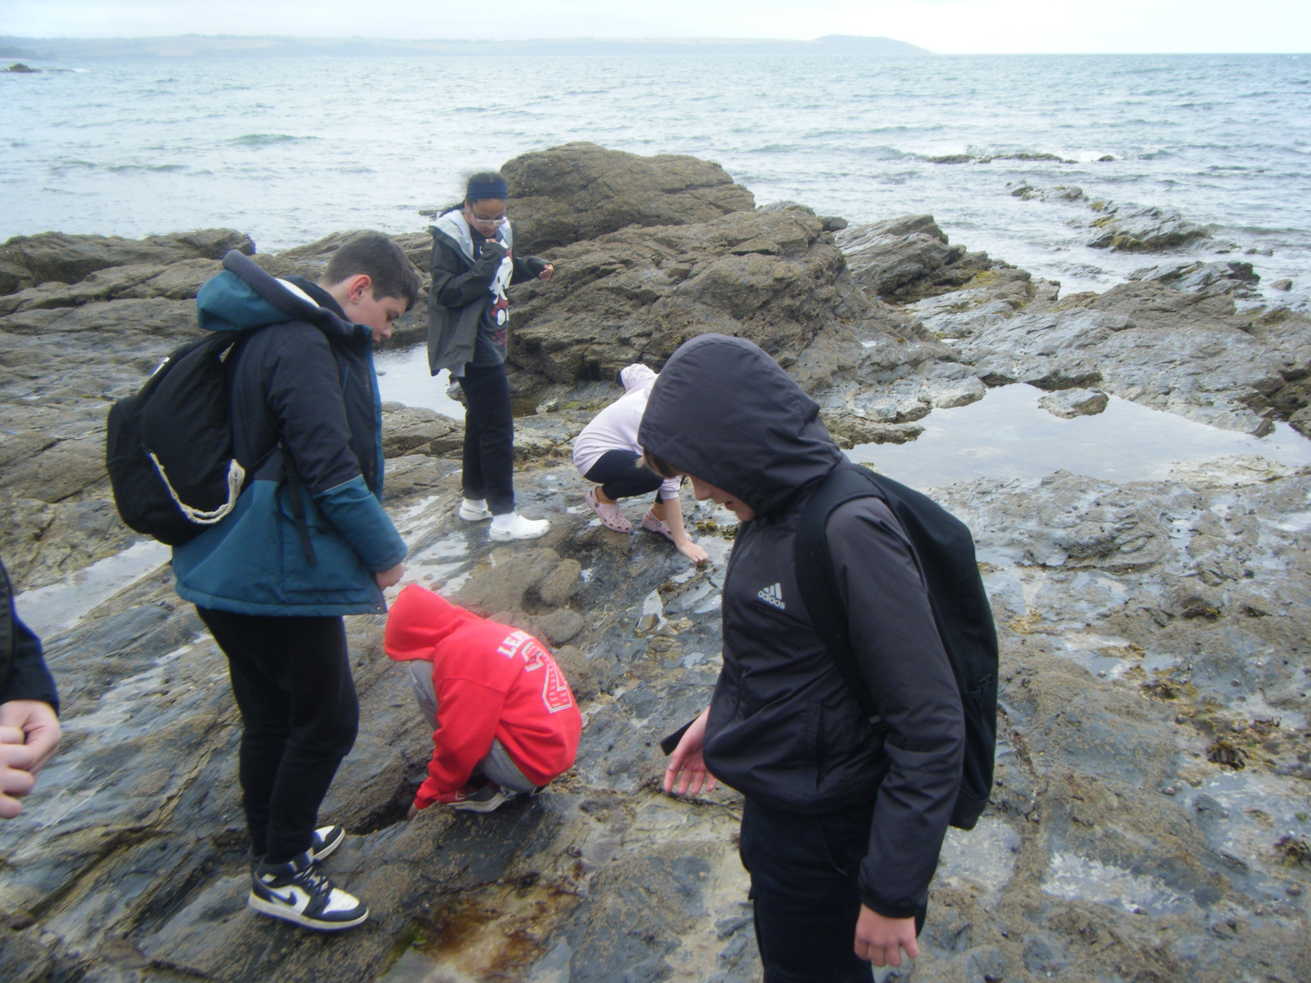

Slide 14
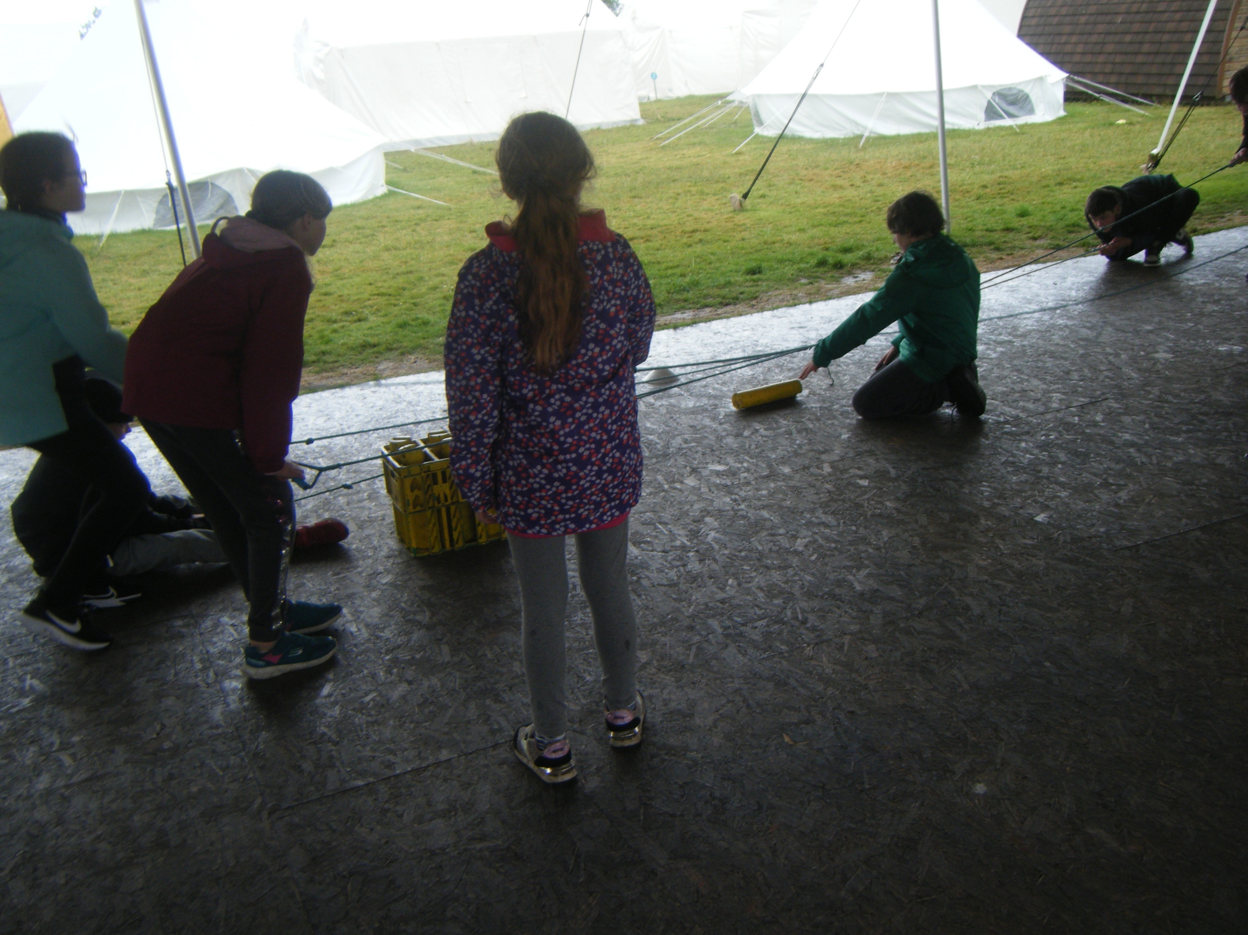

Slide 15
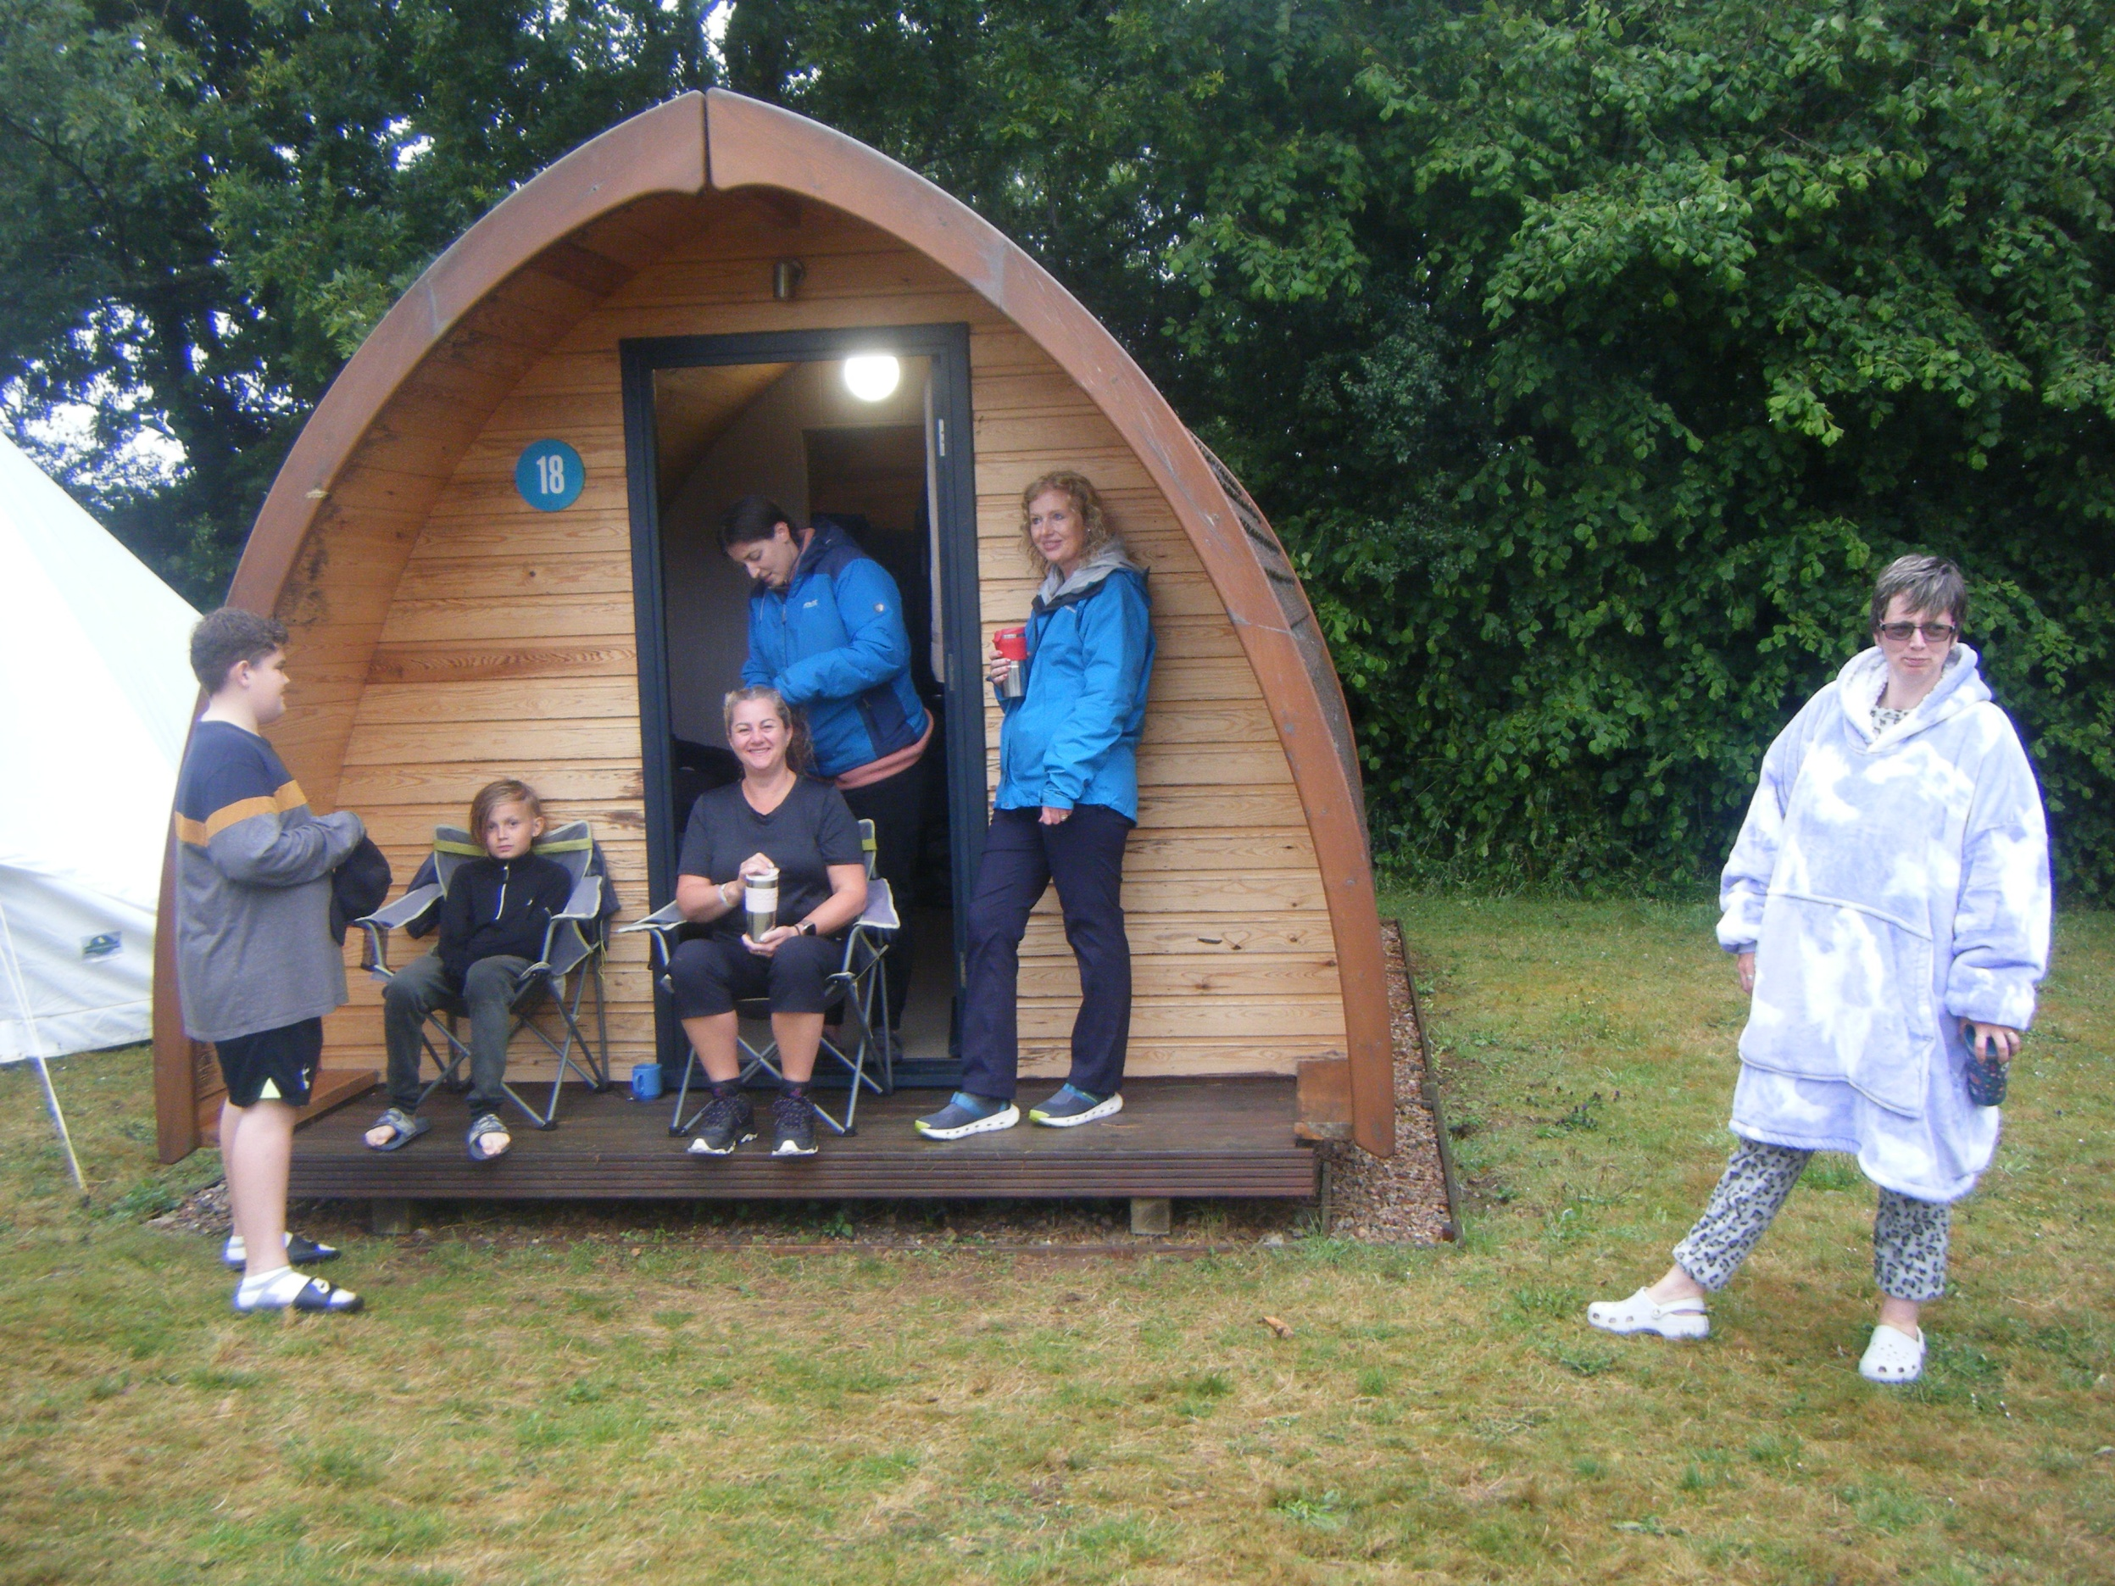

Slide 16
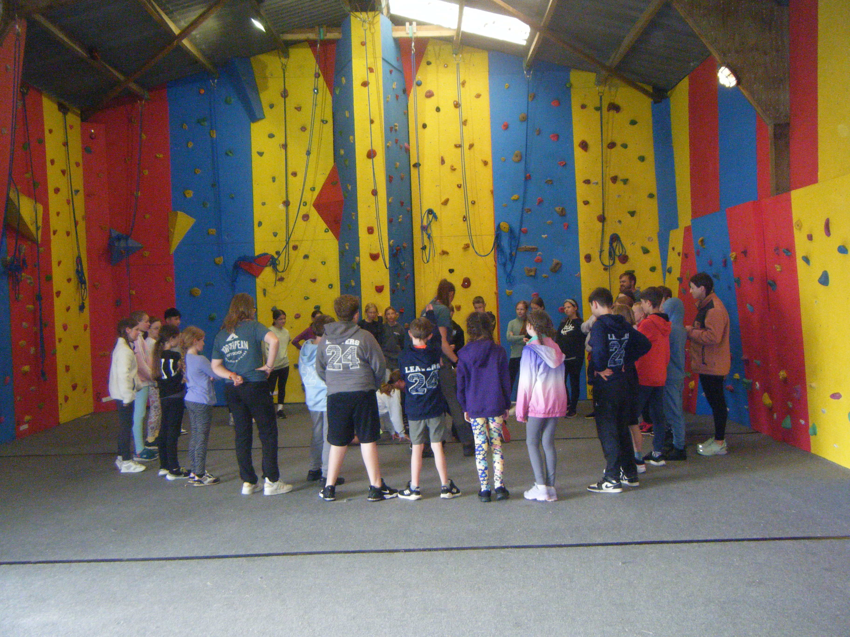

Slide 17
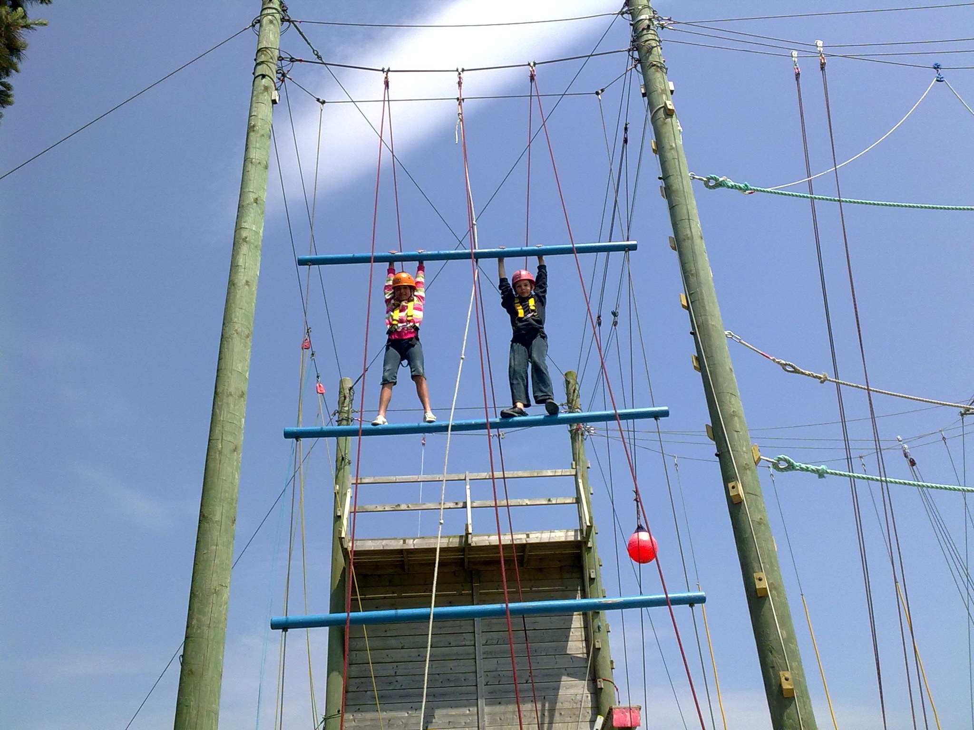

Slide 18
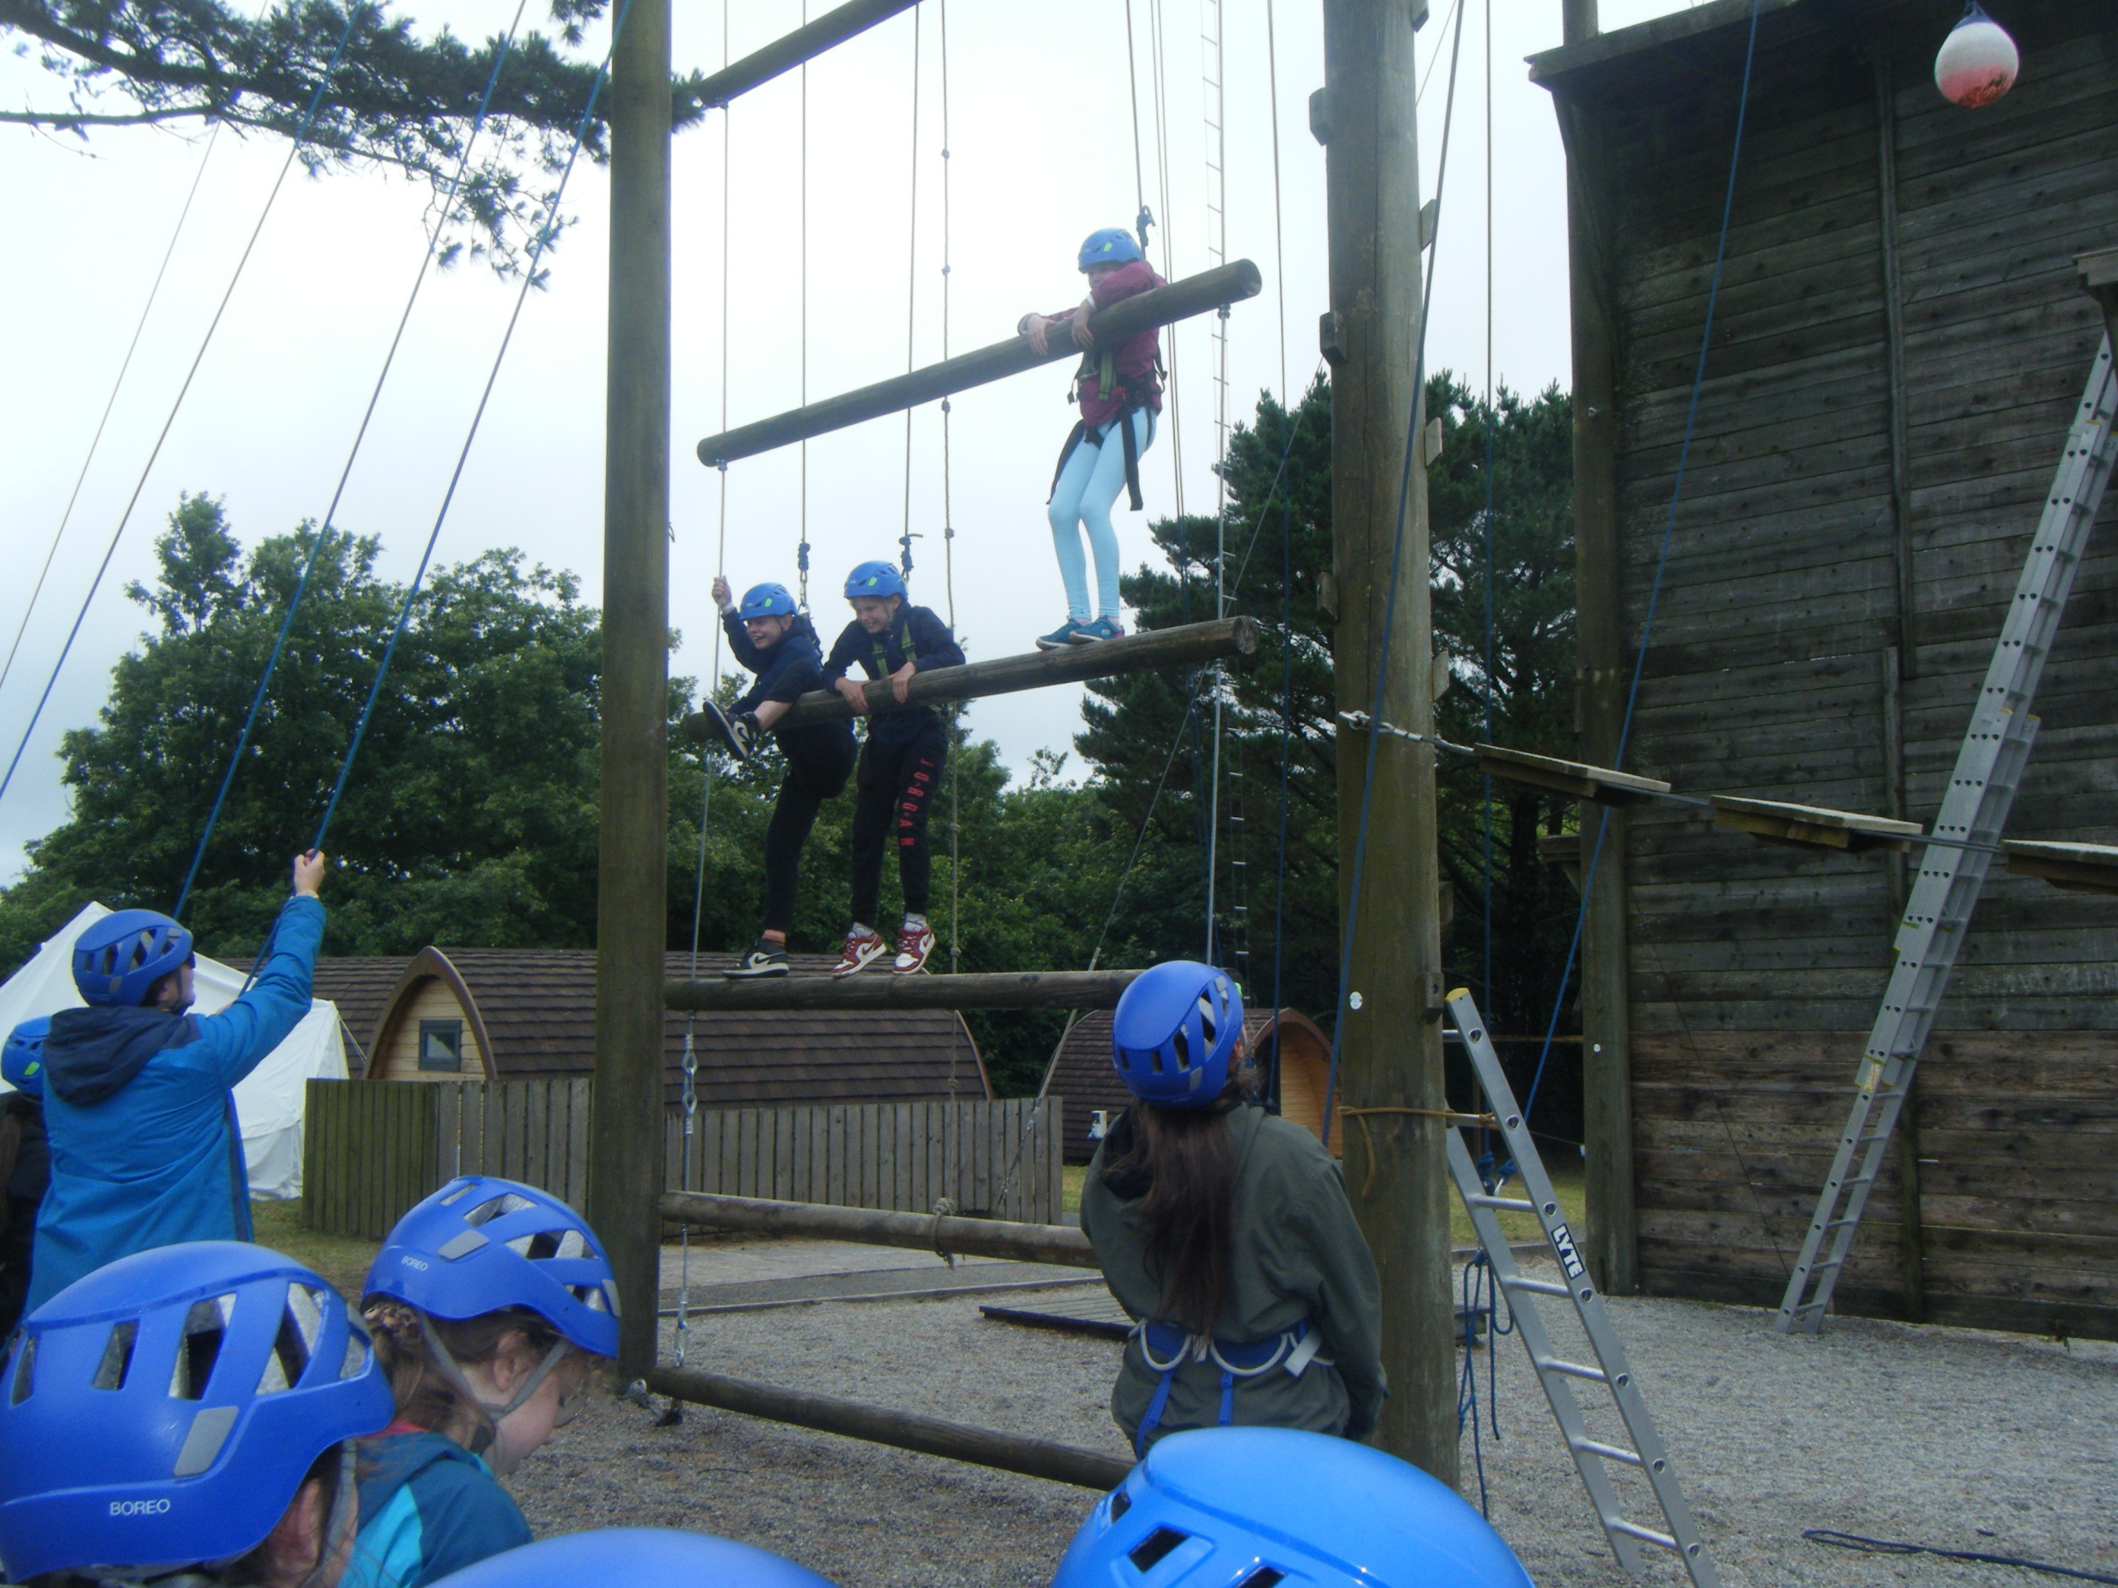

Slide 19
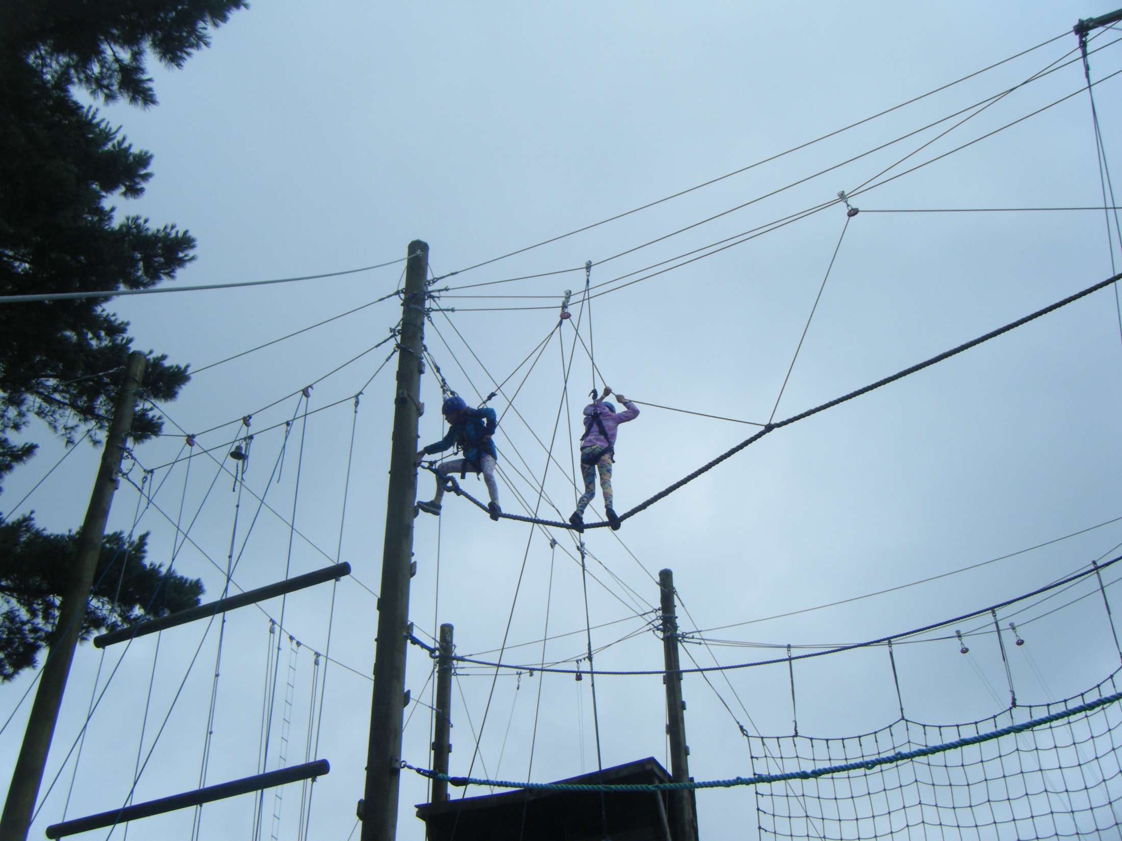

Slide 20
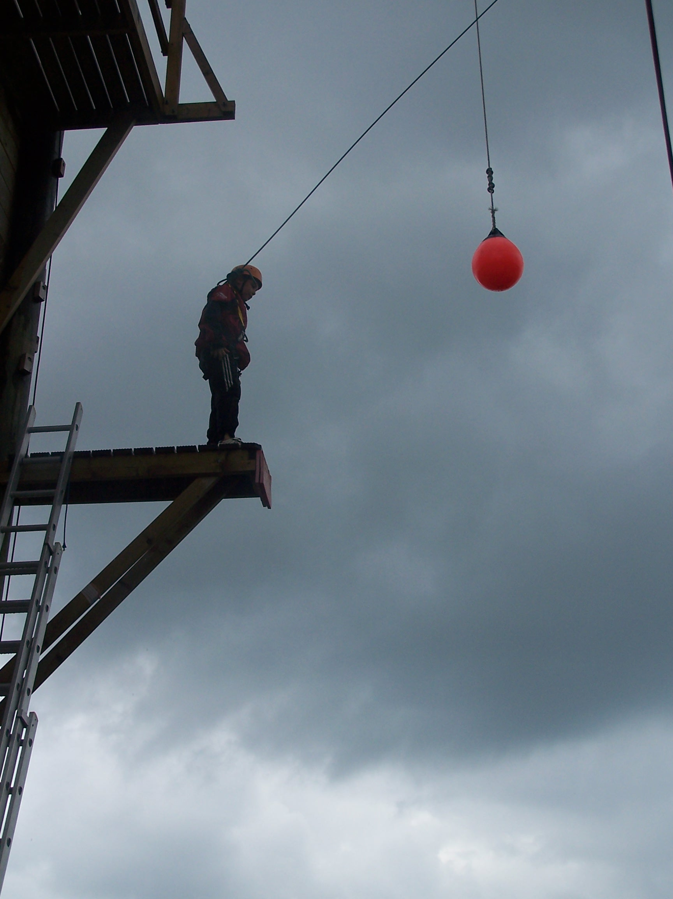

Slide 21
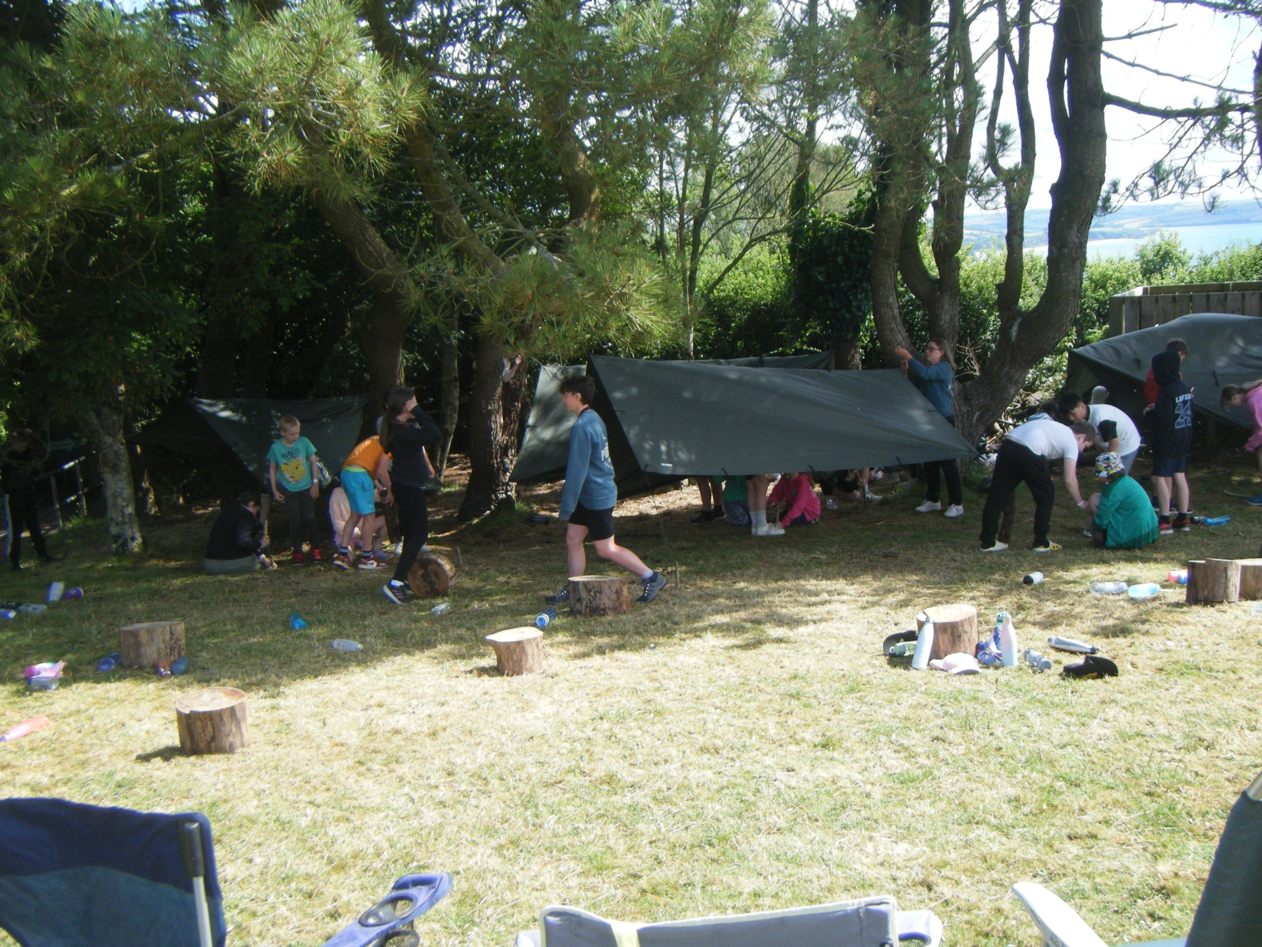

Slide 22
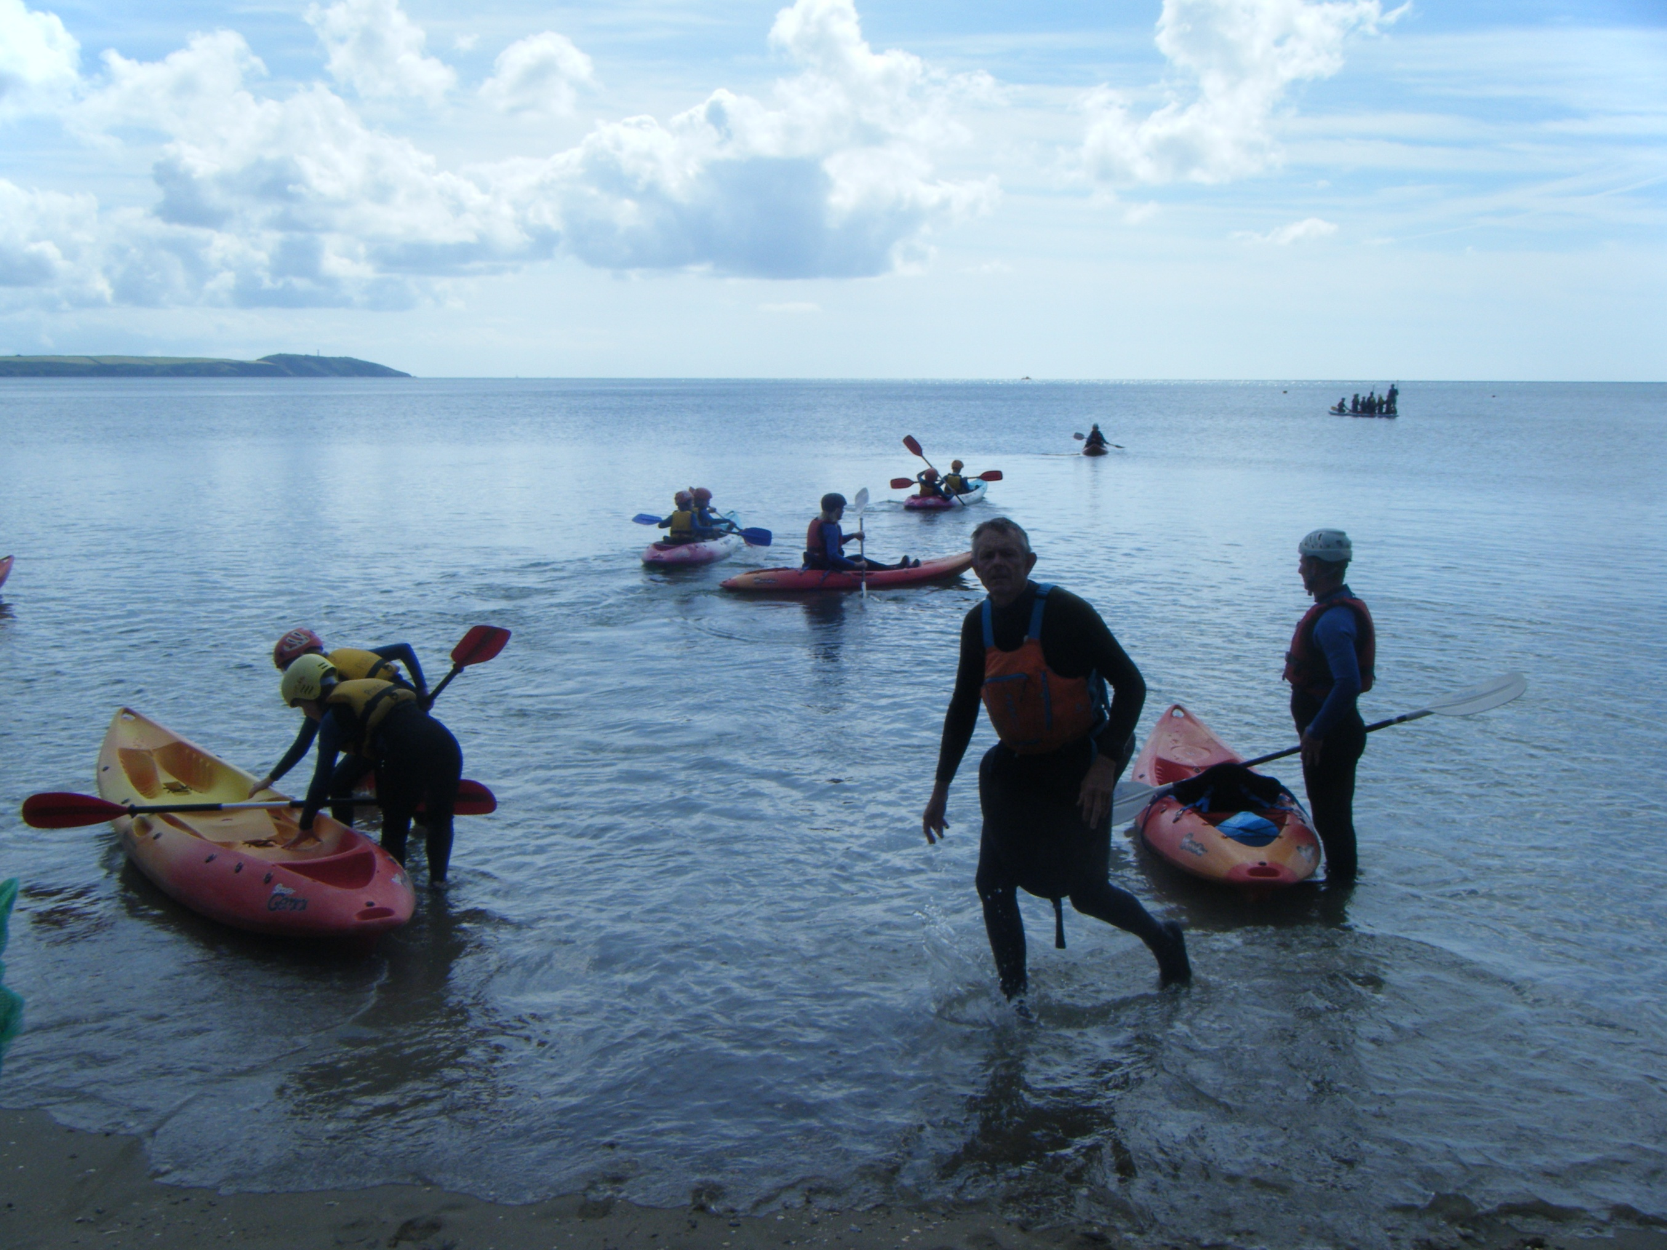

Slide 23
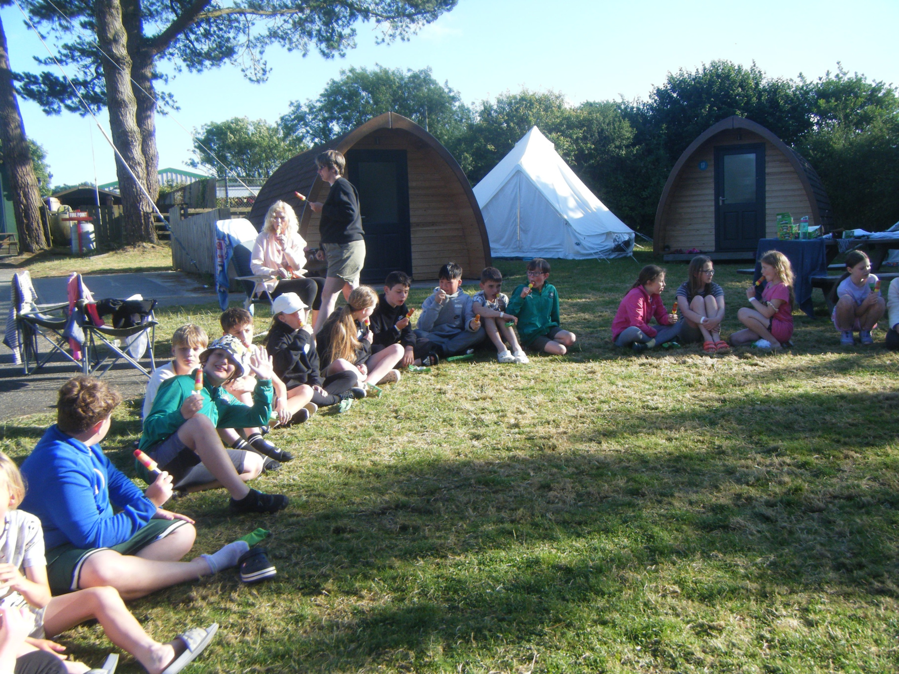

Slide 24
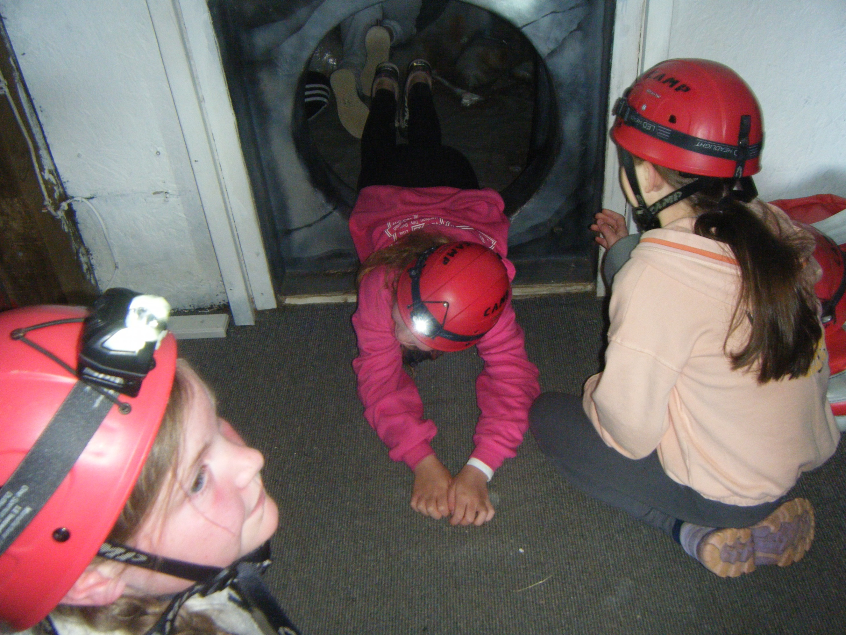

Slide 25
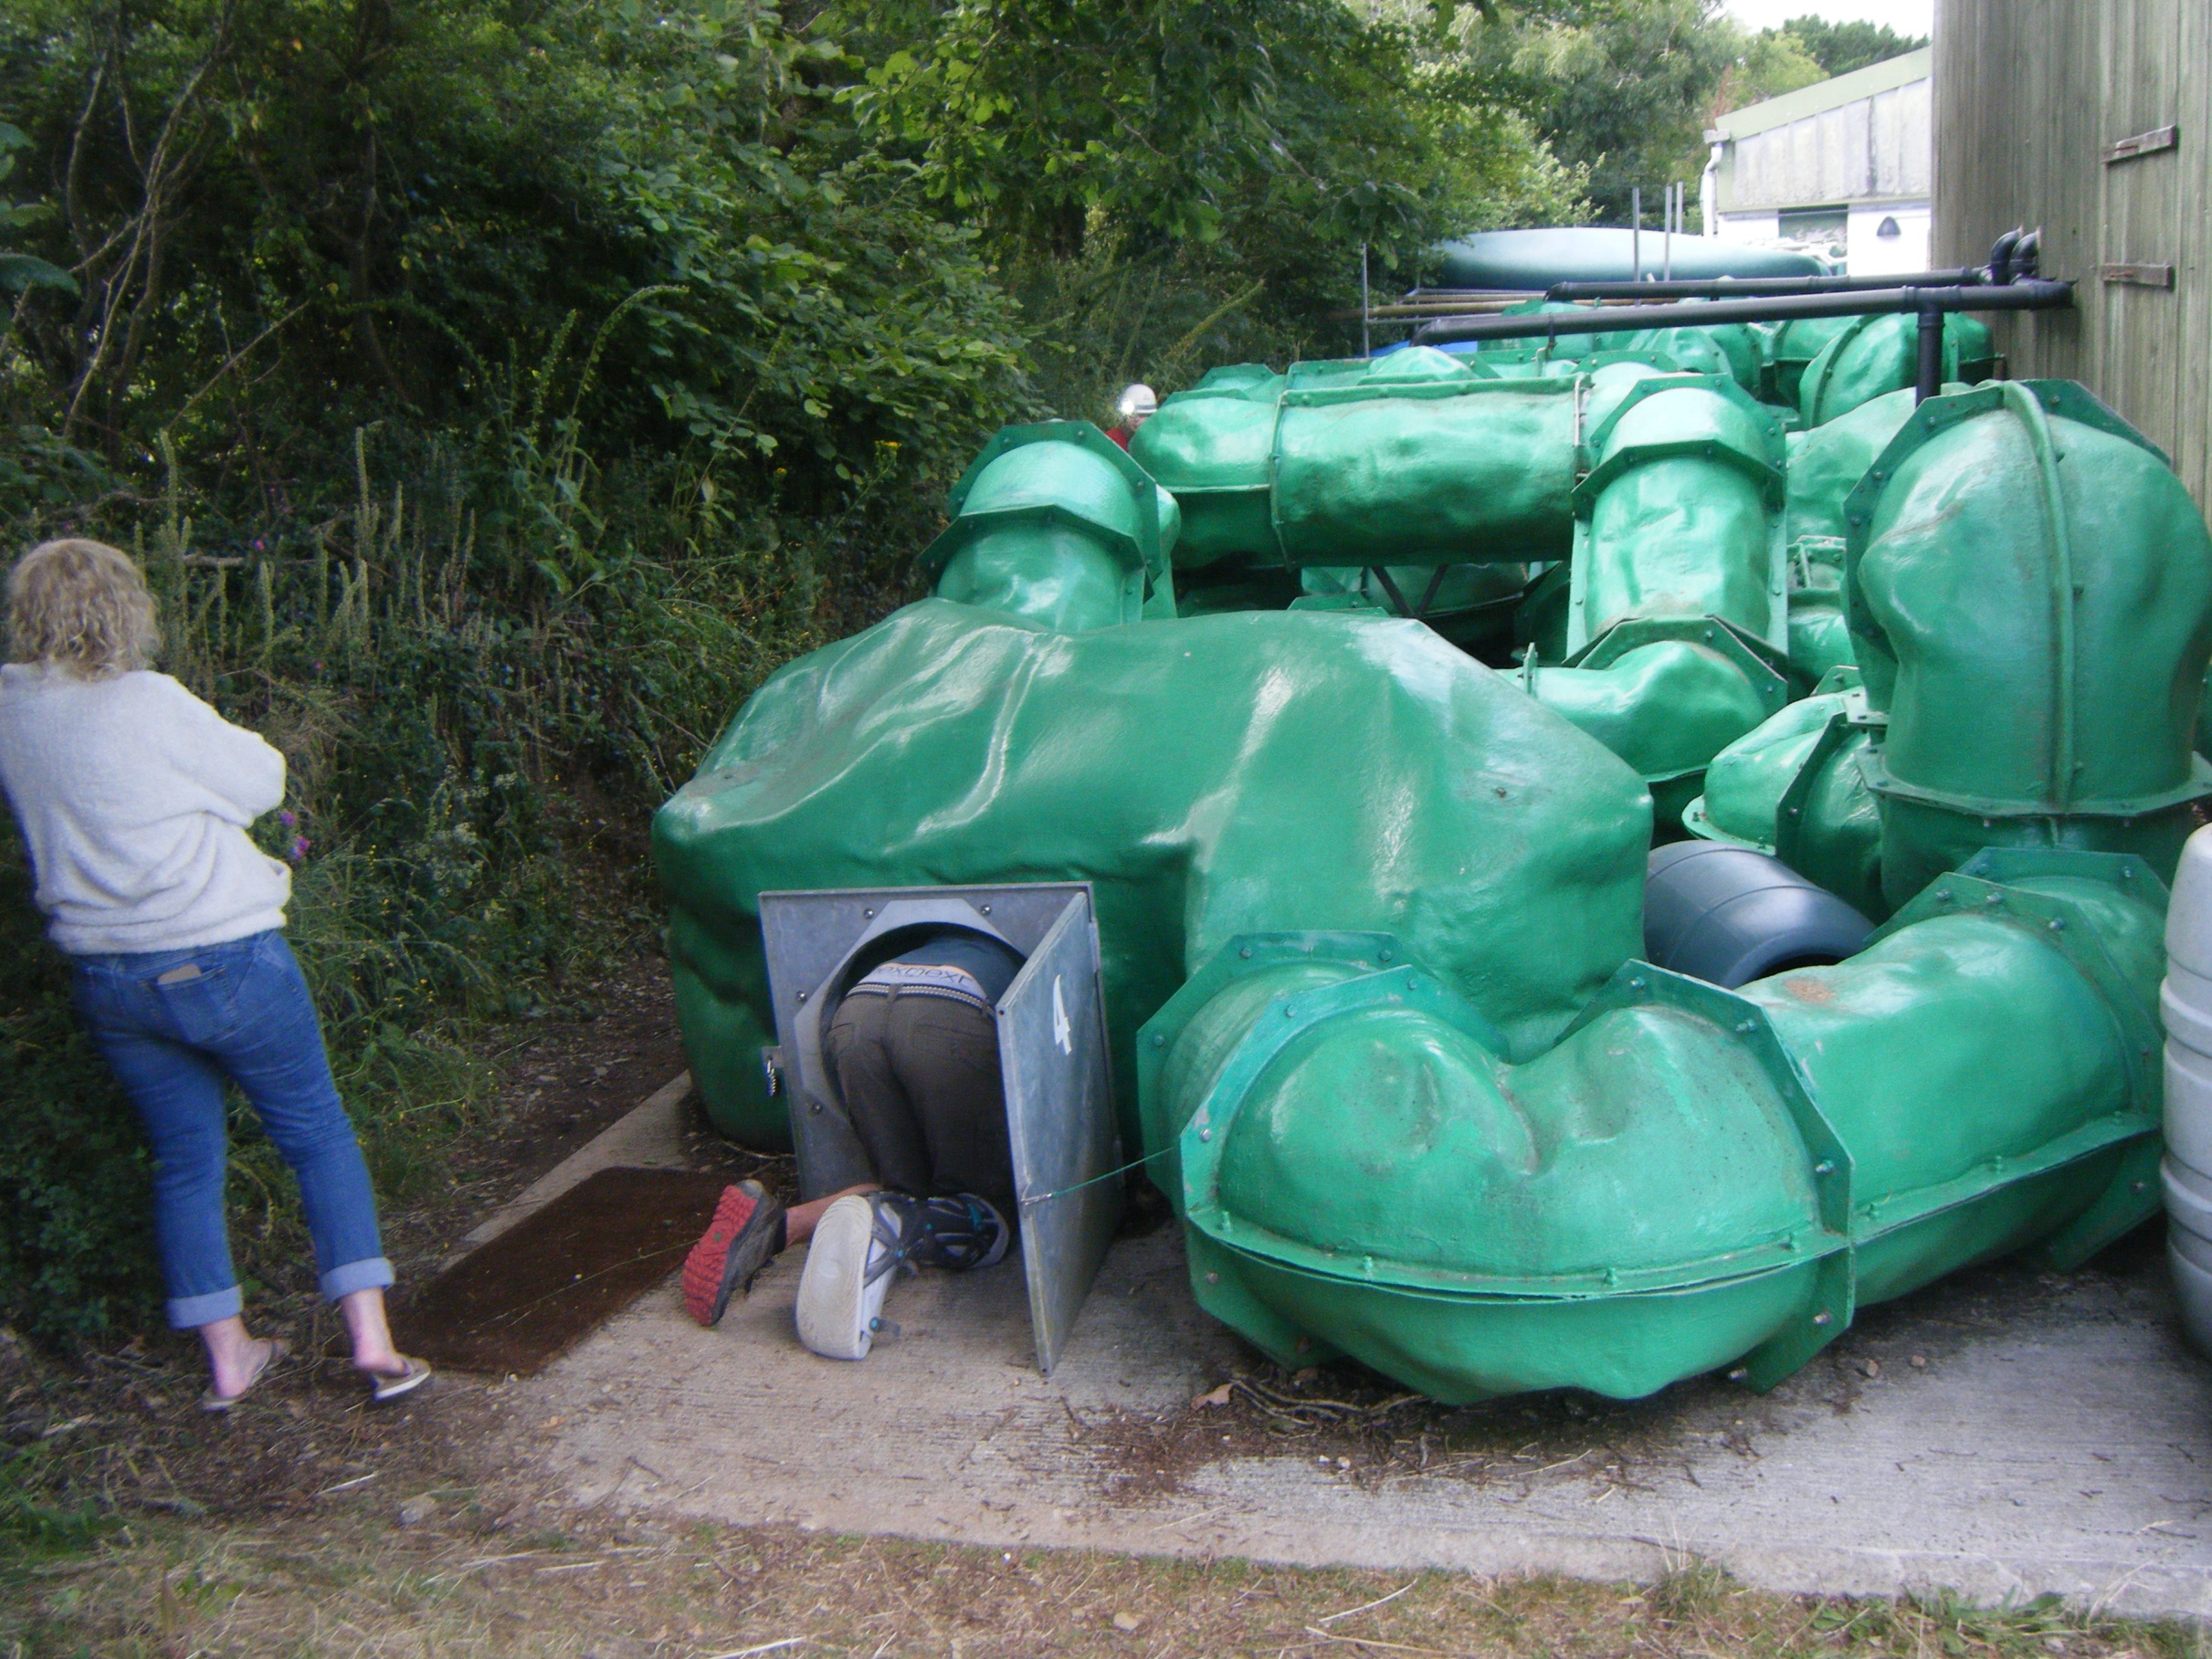

Slide 26
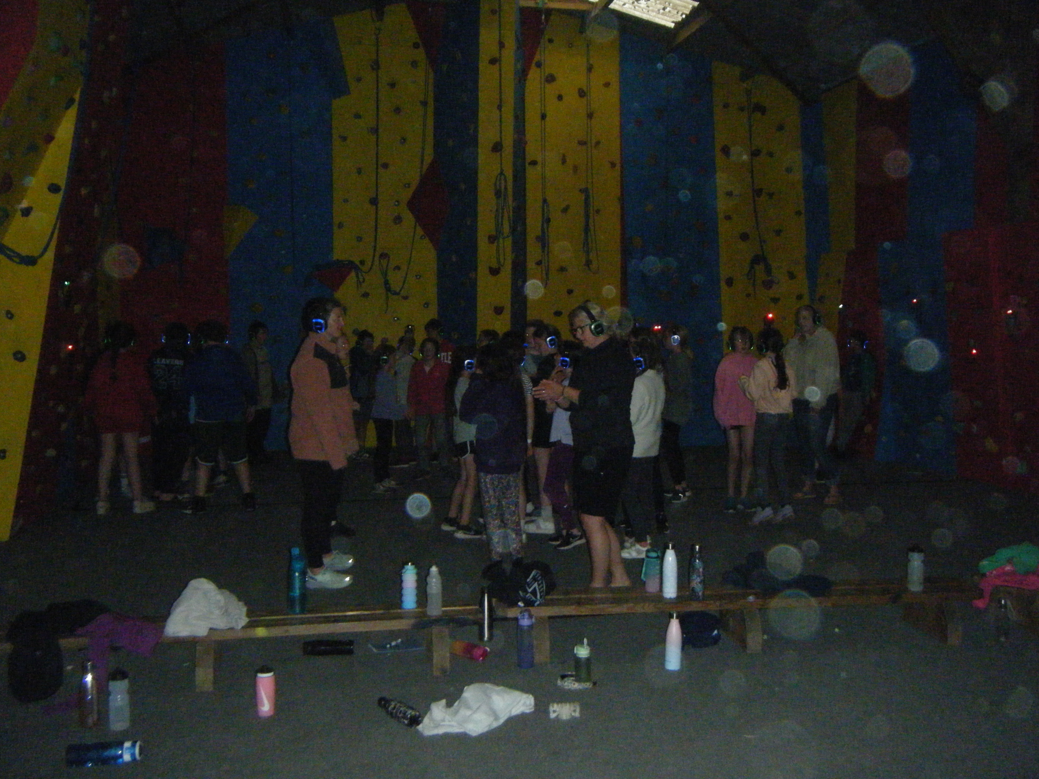

Slide 27
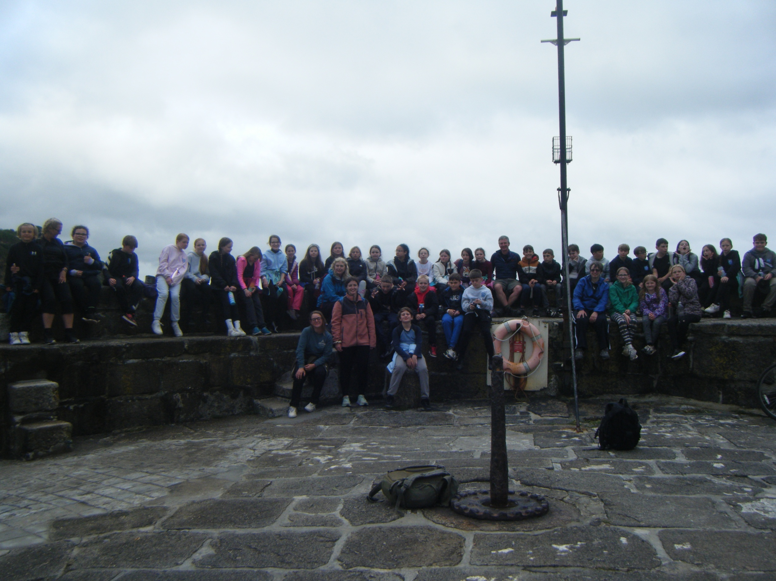

Slide 28
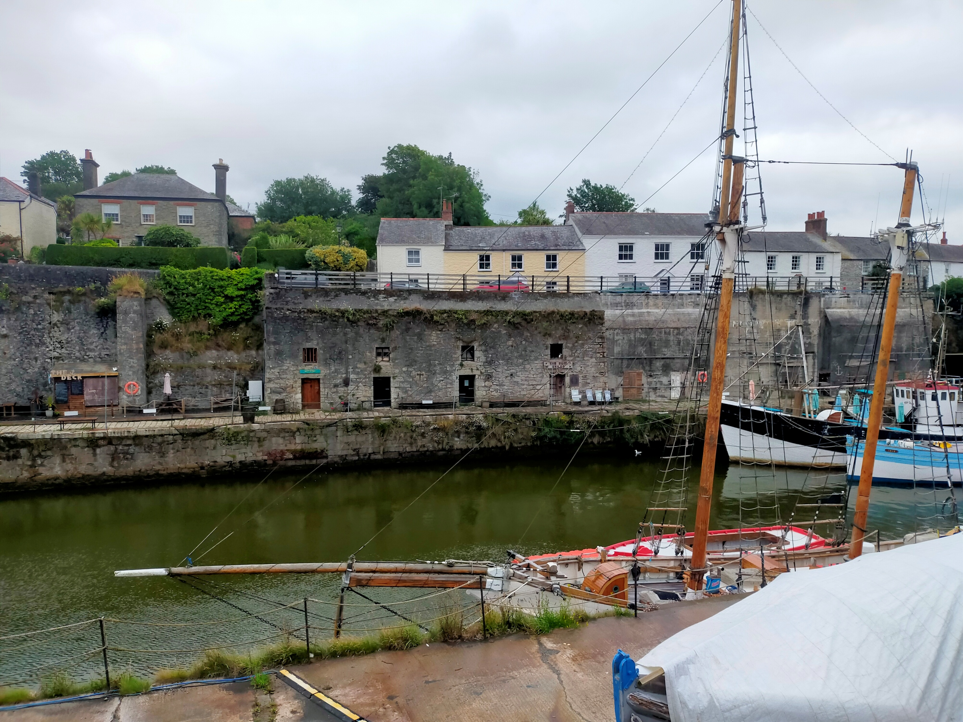

Slide 29
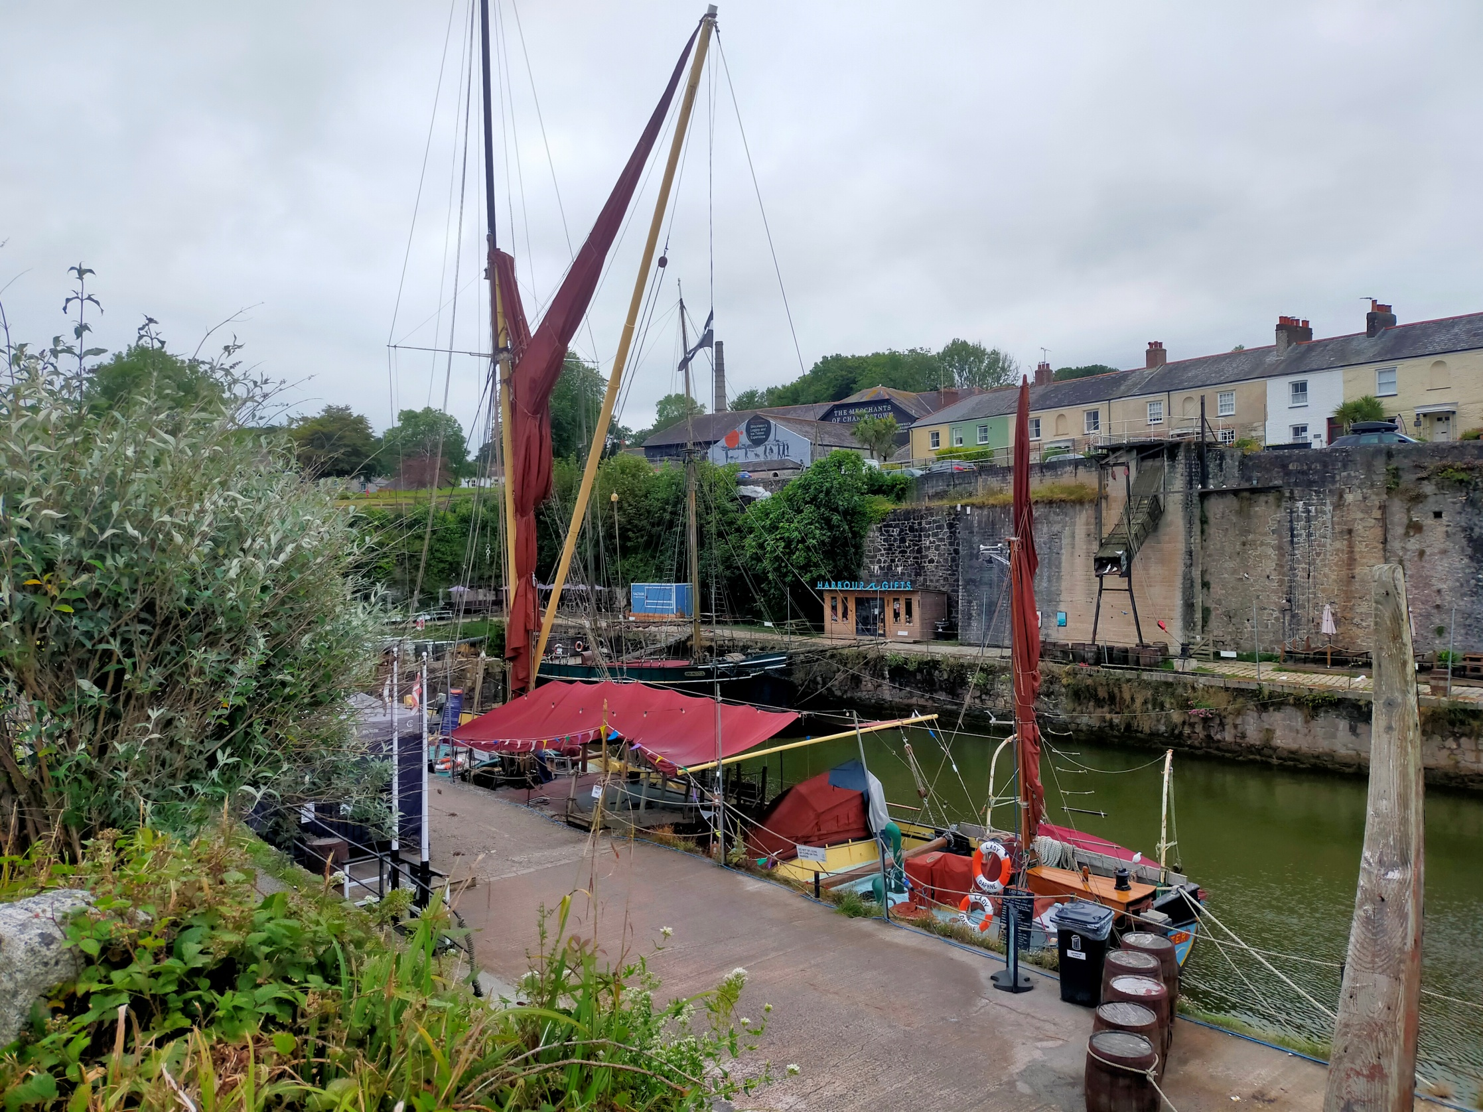

Slide 30
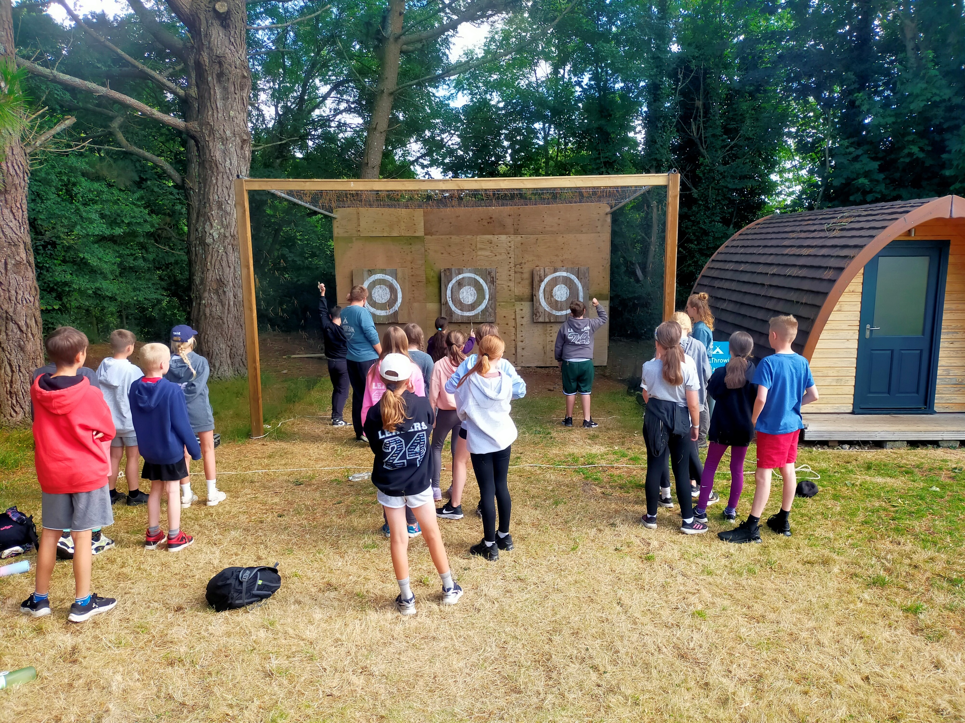

Slide 31
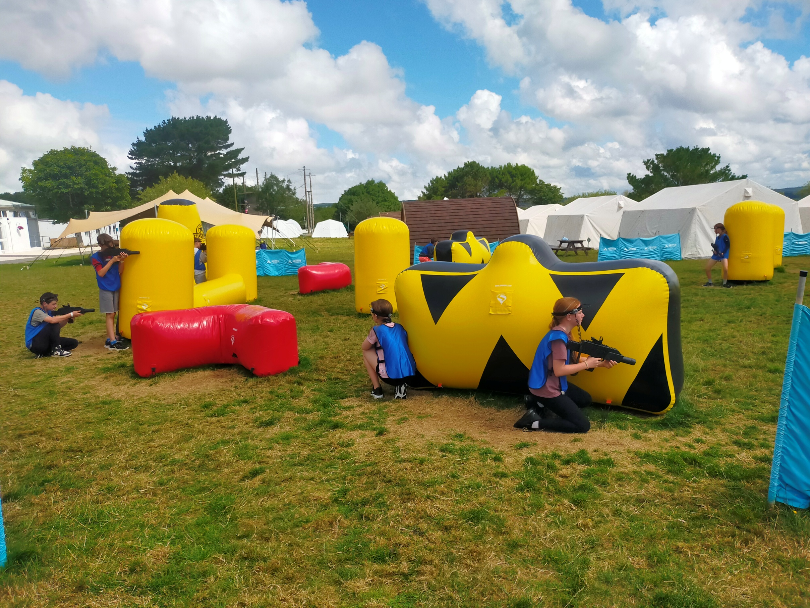

Slide 32
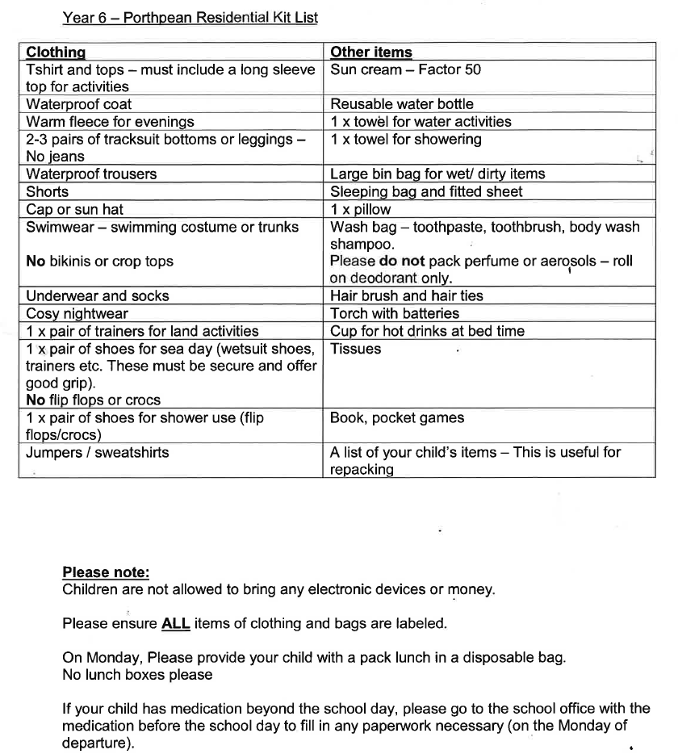

Slide 34
Practical Issues
Remember we are camping
Clothes drying facilities are restricted
Torches are a must
Nothing expensive or precious
No mobile phones or similar
Strong bin liners-named please!
All clothes and possessions should be clearly named.

Slide 35
Camp Arrangements
Boys and girls in separate tents
Friendship groups together whenever possible.
Groups in pods / tents kept to practical sizes.
Wooden base & durable plastic-coated mattresses provided.
Staff always on site including staff first aiders.

Slide 36
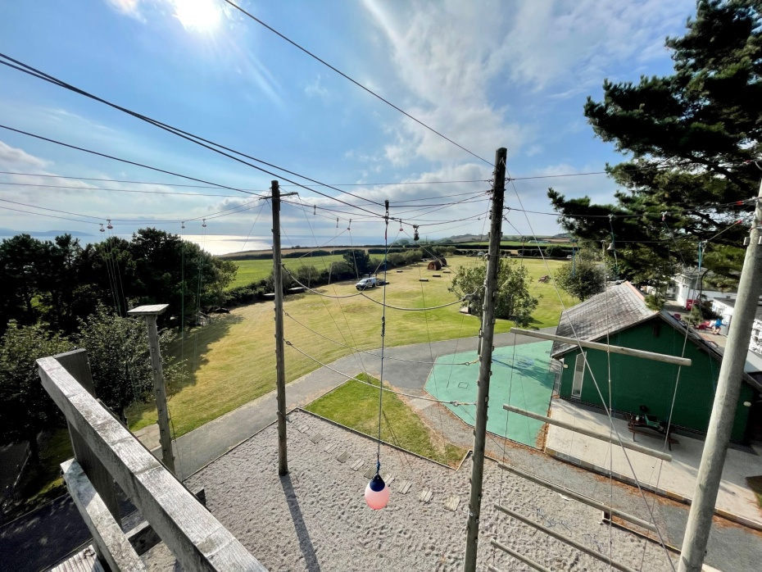
Overall
Not much has changed-apart from new owners, new tents, new evening activities and a new energy!
Porthpean Outdoor Education Centre will continue to offer outstanding adventurous activities
Cornwall Adventure LTD will build on, and make even better everything the centre has always offered.

Slide 37
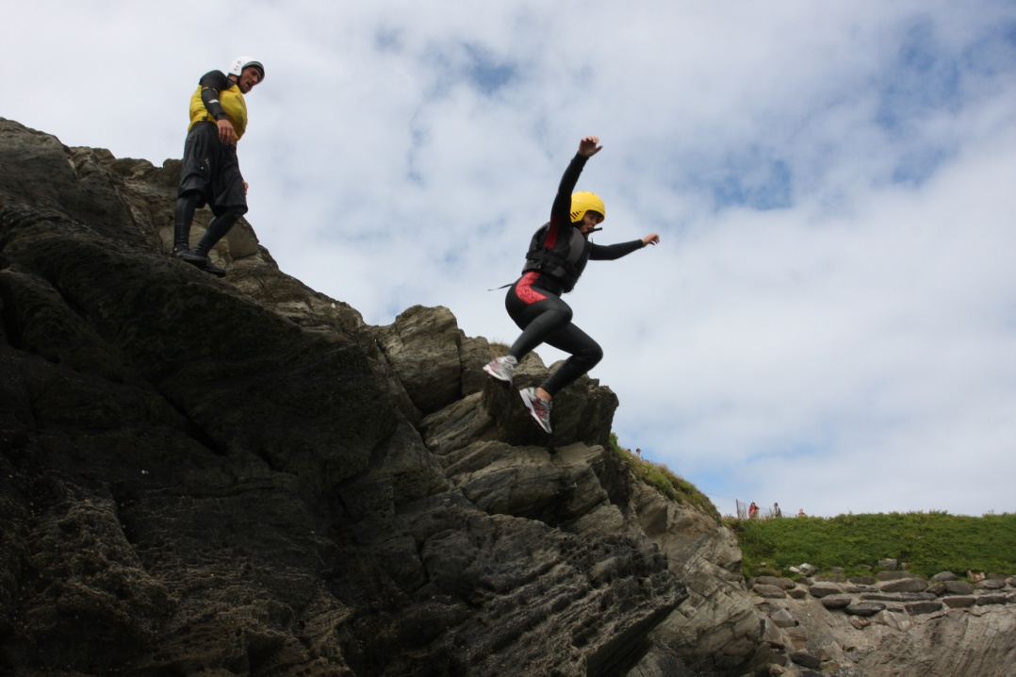
Any Questions?

Slide 38
