Slide 1
HOMEWORK IN UPPER KEY STAGE 2

Slide 2
Knowledge organisers
Your child will receive a knowledge organiser which covers the knowledge and skills they need in each subject for the next 4-6 weeks of learning.
Knowledge organisers can cover English, maths, science, geography, history, art and grammar, punctuation and spelling.
They will ALWAYS include suggested activities.

Slide 3
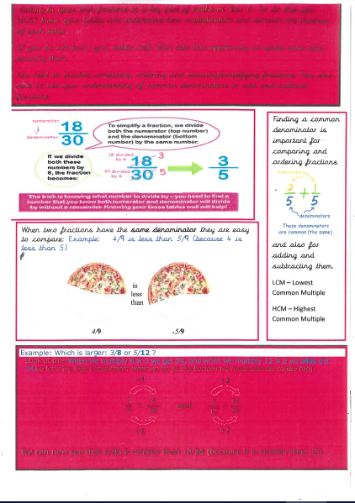
An
Example
Of a
Year 6 Maths
Organiser
Notes:
An example of a y6 maths organiser you may see later in the year.

Slide 4
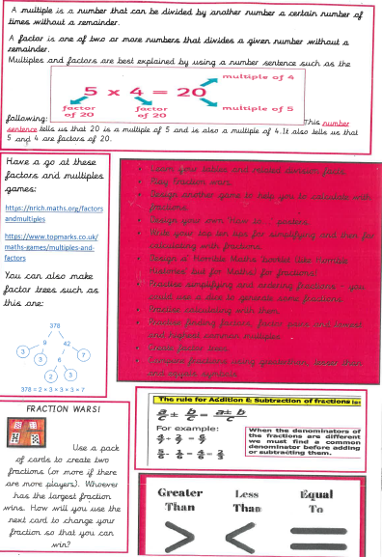

Slide 5
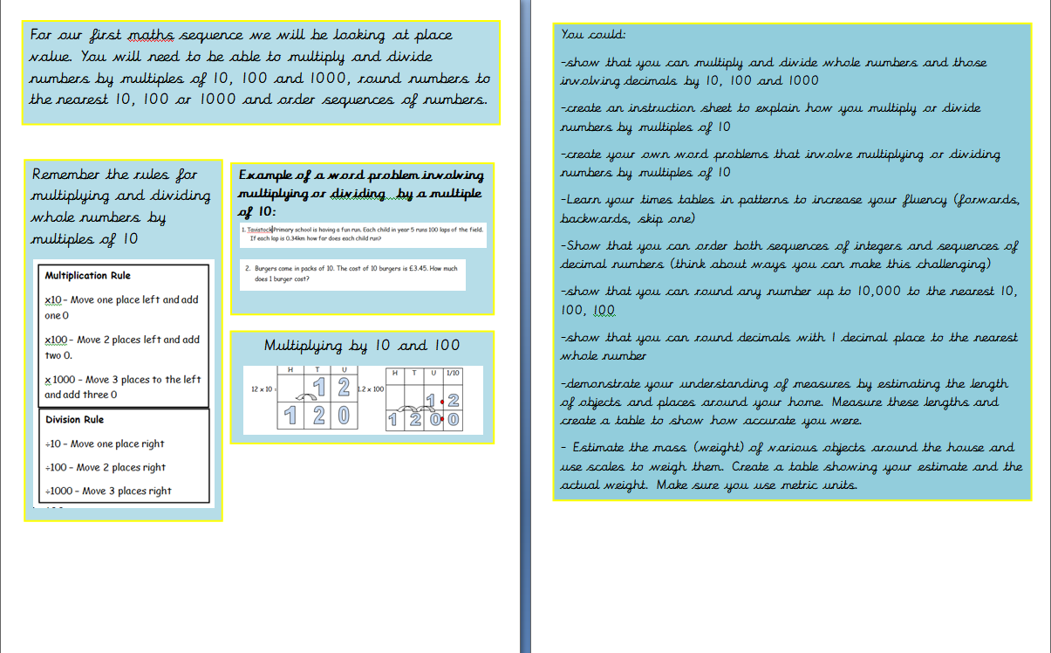
An Example of a Year 5 Maths Organiser

Slide 6
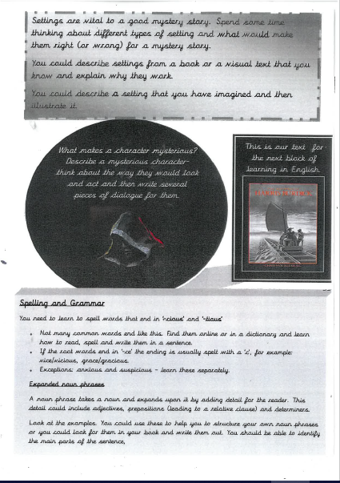
Year 6
English Example
Notes:
An example of an English knowledge organiser you may see later in the year.

Slide 7
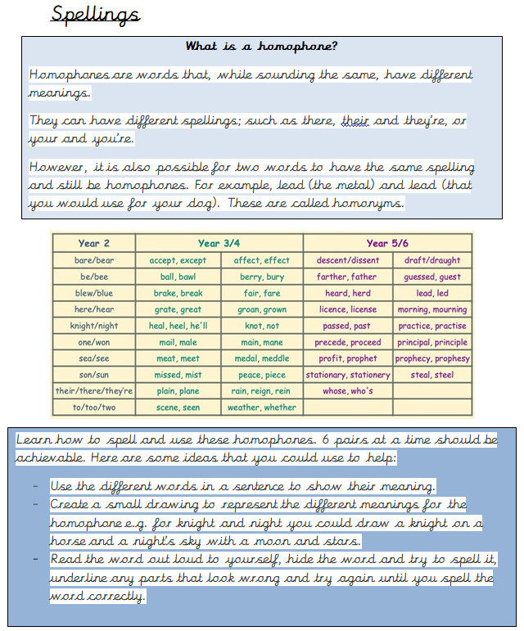
Year 5 Spelling Knowledge Organiser

Slide 8
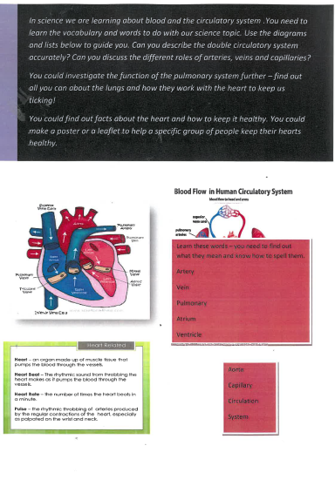
Year 6 Science Knowledge Organiser
Notes:
An example of a science organiser.

Slide 9
Year 5
History
Knowledge
Organiser

Slide 10
Expectations
Two pieces of homework each week
Hand in by Wednesday
A variety of subjects over the 4-6 weeks
Excellent presentation and effort given

Slide 11
THE GOLD STANDARD
The Gold Standard is awarded to any child who shows effort, improvement (in quality and or quantity) , enthusiasm, originality in their work.
There is no limit to the number you can earn and each child’s work is considered individually and not compared to others.
Notes:
The Gold Standard is awarded to any child who shows effort, improvement (in quality and or quantity) , enthusiasm, originality in their work.
There is no limit to the number you can earn and each child’s work is considered individually and not compared to others.

Slide 12
FAQ’S
1.How much homework is enough?
We expect to see two pieces of recorded work in your book and you need to be reading every day.
Do not spend longer than 20 minutes(approximately) on each piece. Plan what you are going to do carefully.
We would rather see less work at a high standard which is written independently than a huge amount copied out .
Notes:
1. Two pieces in their homework books plus reading. Each piece should take approximately twenty minutes.

Slide 13
2.How long should I spend on each subject?
Approximately 20 mins – but some children can choose to spend longer if they are passionate about their work.
Make sure you do a variety of subjects each week – we will be keeping track of this in school.
Notes:
2.Approximately 20 mins – but some children find that they spend much longer if they are passionate about their work.

Slide 14
3.Can I come up with my own ideas?
YES!
We encourage creativity and getting original pieces of work in.
Collaboration with family members is also a great way of coming up with original ideas.
Always ensure that your work meets the standards expected in Upper Key Stage 2
Notes:
3. Definitely. We love originality in Year 6 so it would be great if you can complete work of a Y6 standard using your own ideas.

Slide 15
4.What happens if I don’t understand or don’t know what to do?
Homework will be related to your current learning in class so you should always have an idea of what you need to do.
If you need help or need ideas then speak to a teacher or teaching assistant BEFORE Wednesday.
Notes:
4. Homework is given to you at the beginning of a new sequence so if you are stuck for an idea then you MUST speak to an adult before Wednesday each week.

Slide 16
EXAMPLES OF HOMEWORK COMPLETED USING KNOWLEDGE ORGANISERS

Slide 17
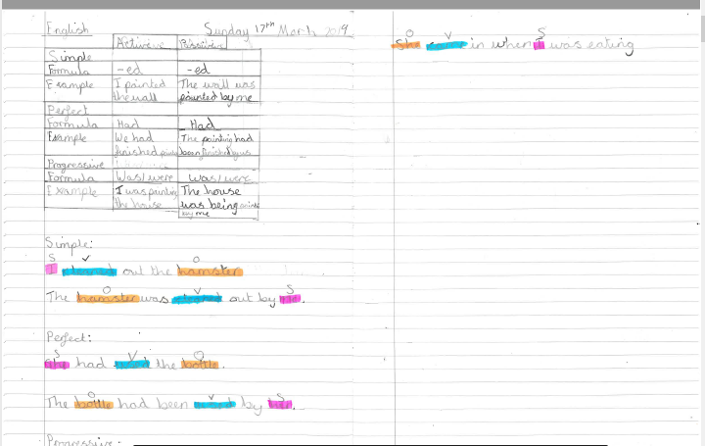
Notes:
Children’s examples
Neatly presented, appropriate stationery ( please do speak to us if you need any help with this), dated and titled.

Slide 18
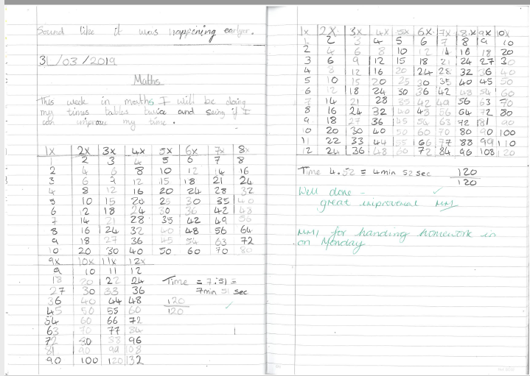

Slide 19
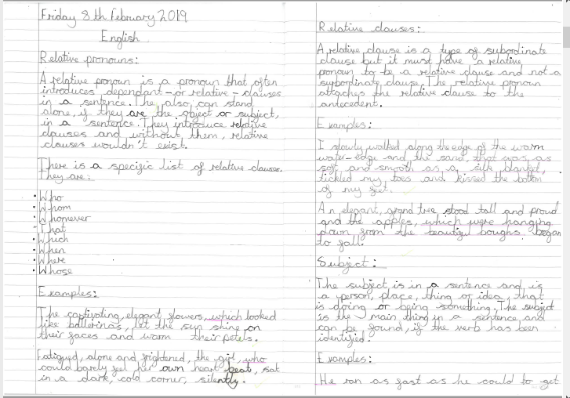

Slide 20
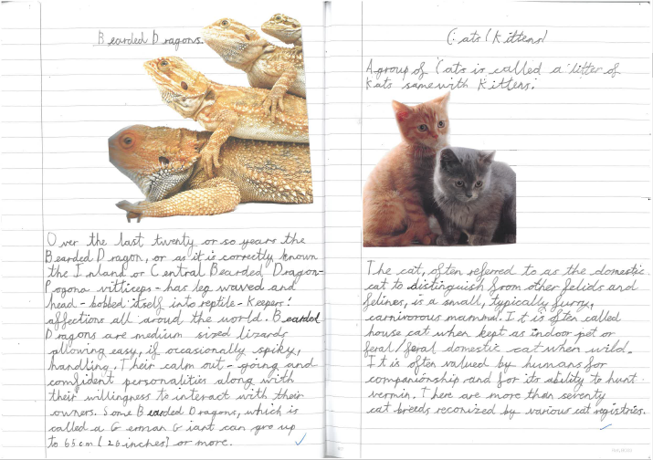

Slide 21
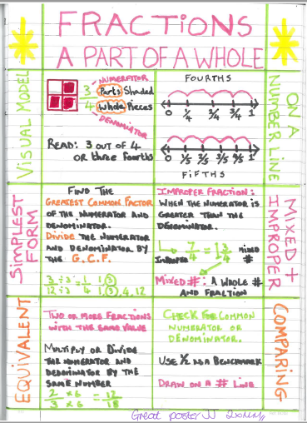
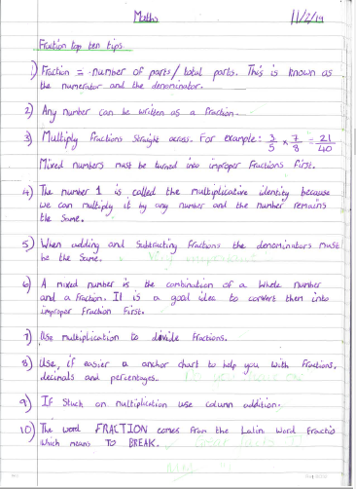

Slide 22
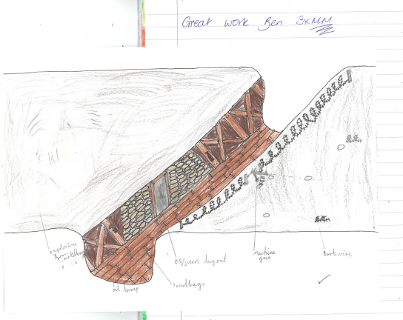

Slide 23
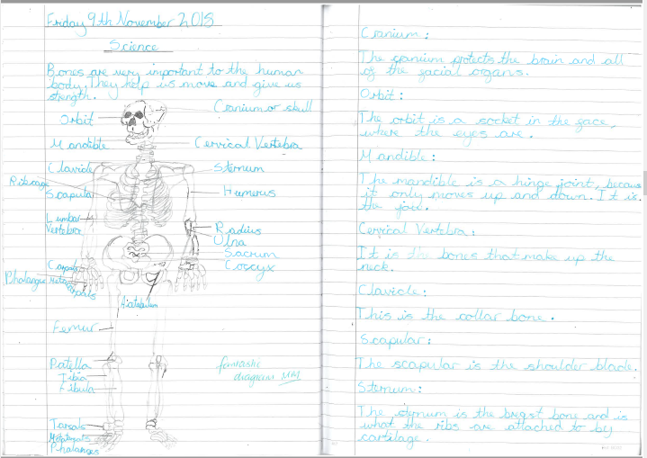

Slide 24
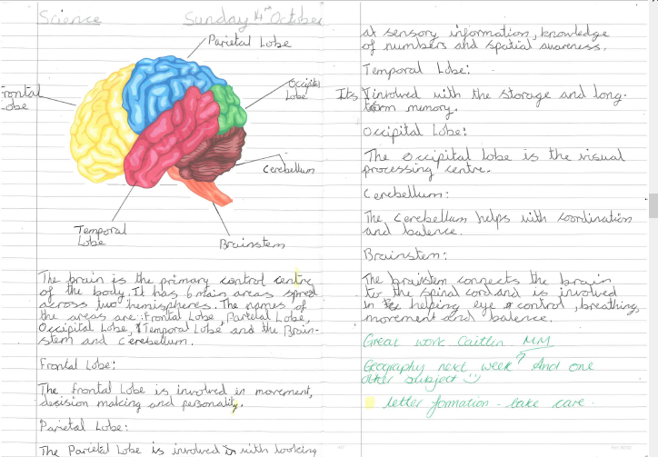

Slide 25
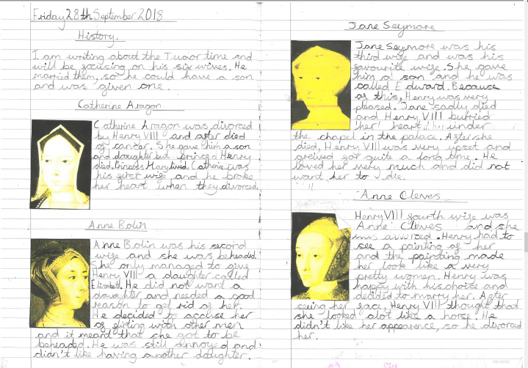
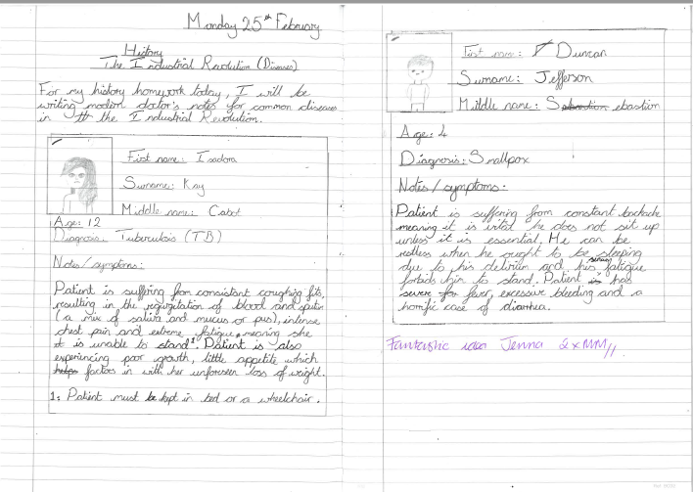

Slide 26
PLEASE DON’T PANIC!
We will give the children clear guidance
We are always happy to help where we can with resources
We will always support a child who is struggling to come up with ideas or is finding the homework challenging
We recognise effort and improvement alongside having the highest expectations of our Y5 and Y6 children.
We understand that free choice can be more difficult to manage than just completing a set number of questions – the children do get used to this and become really good at producing the right amount of work in their subjects of choice.
Notes:
Choice can be unsettling and make both parents/carers and children unsure. We completely understand this and are ready to support and answer any questions.

